Slide 1
Machine Learning ZG565
Dr. Sugata Ghosal
Sugata.ghosal@pilani.bits-pilani.ac.in

Slide 2
Session 1
Date – 20th May 2023
Time – 2 PM to 4 PM
These slides are prepared by the instructor, with grateful acknowledgement of many others who made their course materials freely available online.

Slide 3
Session Content
Objective of course
Evaluation Plan
What is Machine Learning?
Application areas of Machine Learning
Why Machine Learning is important?
Design a Learning System
Issues in Machine Learning

Slide 4
Objective of course
Introduction to the basic concepts and techniques of Machine Learning
Gain experience of doing independent study and research in the field of Machine Learning
Develop skills of using recent machine learning software tools to evaluate learning algorithms and model selection for solving practical problems

Slide 5
What We’ll Cover in this Course
Supervised learning algorithms
Regression
Naïve Bayes
Logistic regression
Decision Tree and Random Forest
Support vector machines
Ensemble Techniques
Unsupervised learning
Clustering
Applications

Slide 6
Books
Text books and Reference book(s)
T1 | Tom M. Mitchell: Machine Learning, The McGraw-Hill Companies
R1 R2 R3 | Christopher M. Bishop: Pattern Recognition & Machine Learning, Springer P. Tan, et al. Introduction to Data Mining, Pearson C.J.C. BURGES: A Tutorial on Support Vector Machines for Pattern Recognition, Kluwer Academic Publishers, Boston.
Notes:
The requirements of information security within an organization have undergone two major changes in the last several decades. Before the widespread use of data processing equipment,the security of information felt to be valuable to an organization was provided primarily by physical (eg. rugged filing cabinets with locks) and administrative mechanisms (eg. Personnel screening procedures during hiring process).
Growing computer use implies a need for automated tools for protecting files and other information stored on it. This is especially the case for a shared system, such as a time-sharing system, and even more so for systems that can be accessed over a public telephone network, data network, or the Internet.
The second major change that affected security is the introduction of distributed systems and the use of networks and communications facilities for carrying data between terminal user and computer and between computer and computer. Network security measures are needed to protect data during their transmission.

Slide 7
Evaluation Plan
Name | Type | Weight
3 Quiz, best 2 scores will be taken | Online | 10%
Assignment-I | Take Home | 10%
Assignment-II | Take Home | 10%
Mid-Semester Test | Closed Book | 30%
Comprehensive Exam | Open Book | 40%
Please note there will be no change in submission dates for quiz and assignment

Slide 8
Lab Plan
Lab No. | Lab Objective
1 | End to End Machine Learning
2 | Linear Regression and Gradient Descent Algorithm
3 | Logistic Regression Classifier
4 | Decision Tree
5 | Naïve Bayes Classifier
6 | Random Forest
Labs not graded
Most of the Lab recordings available at CSIS virtual labs
Webinars will be conducted for lab sessions
Labs will be conducted in Python

Slide 9
Machine Learning
Machine learning is a scientific discipline that explores the construction and study of algorithms that can learn from data.
Such algorithms operate by building a model based on inputs and using that to make predictions or decisions, rather than following only explicitly programmed instructions.

Slide 10
A Few Quotes
“A breakthrough in machine learning would be worth ten Microsofts” (Bill Gates, Chairman, Microsoft)
“Machine learning is the next Internet” (Tony Tether, Director, DARPA)
“Web rankings today are mostly a matter of machine learning” (Prabhakar Raghavan, Dir. Research, Yahoo)
“Machine learning is going to result in a real revolution” (Greg Papadopoulos, CTO, Sun)
“Machine learning is today’s discontinuity” (Jerry Yang, CEO, Yahoo)

Slide 11
Traditional Programming
Computer
Data Program
Output
Machine Learning
Computer
Data Output
Program
Slide credit: Pedro Domingos

Slide 12
What is Machine Learning?
Definition by Tom Mitchell (1998):
"A computer program is said to learn from experience E with respect to some class of tasks T and performance measure P, if its performance at tasks in T, as measured by P, improves with experience E.” Example: playing checkers.
E = the experience of playing many games of checkers
T = the task of playing checkers.
P = the probability that the program will win the next game.

Slide 13
What is Machine Learning?
To have a learning problem, we must identify
The class of tasks
The measure of performance to be improved
Source of experience

Slide 14
Example of Learning Problems

Slide 15
A Checker Learning Problem
Task T: Playing Checkers
Performance Measure P: Percent of games won against opponents
Training Experience E: To be selected ==> Games Played against itself

Slide 16
A handwriting recognition learning problem
Task T: recognizing and classifying handwritten words within images
Performance measure P: percent of words correctly classified
Training Experience E: a database of handwritten words with given classifications

Slide 17
A robot driving learning problem
Task T: driving on public four-lane highways using vision sensors
Performance measure P: average distance travelled before an error (as judged by human)
Training experience E: a sequence of images and steering commands recorded while observing a human driver

Slide 18
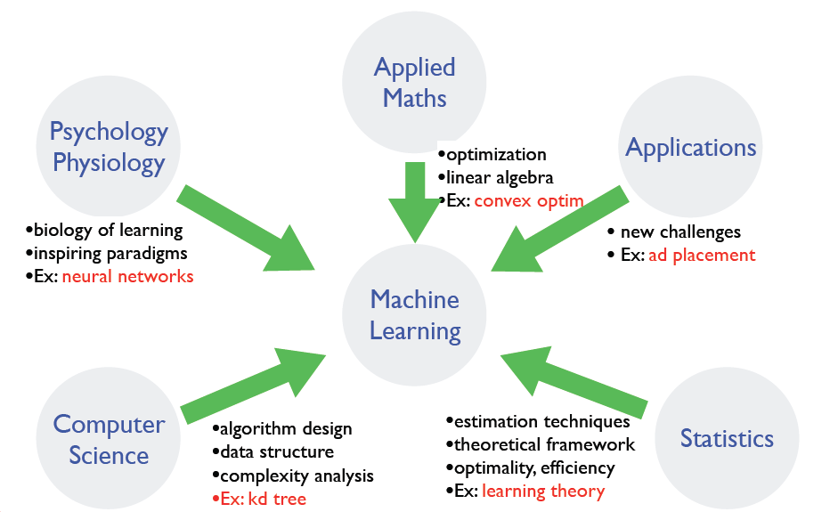
Where does ML fit in?
Slide credit: Dhruv Batra, Fei Sha

Slide 19
Why is Machine Learning Important?
Some tasks cannot be defined well, except by examples.
Relationships and correlations can be hidden within large amounts of data. Machine Learning may be able to find these relationships.
Human designers often produce machines that do not work as well as desired in the environments in which they are used.

Slide 20
Why is Machine Learning Important ?
The amount of knowledge available about certain tasks might be too large for explicit encoding by humans (e.g., medical diagnostic).
New knowledge about tasks is constantly being discovered by humans. It may be difficult to continuously re-design systems “by hand”.

Slide 21

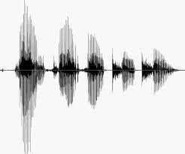
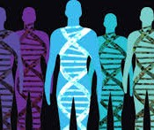
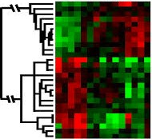
When Do We Use Machine Learning?
ML is used when:
Human expertise does not exist (navigating on Mars)
Humans can’t explain their expertise (speech recognition)
Models must be customized (personalized medicine)
Models are based on huge amounts of data (genomics)
Learning isn’t always useful:
There is no need to “learn” to calculate payroll
Slide Credit: Eric Eaton

Slide 22
Application Domains
Web search
Computational biology
Finance
E-commerce
Space exploration
Robotics
Information extraction
Social networks
Language Processing
Many more emerging…
Slide credit: Pedro Domingos

Slide 23
State of the Art Applications of Machine Learning
.

Slide 24
Application Types
Medical diagnosis
Credit card applications or transactions
Fraud detection in e-commerce
Worm detection in network packets
Spam filtering in email
Recommended articles in a newspaper
Recommended books, movies, music, or jokes
Financial investments
DNA sequences
Spoken words
Handwritten letters
Astronomical images
Slide credit: Ray Mooney

Slide 25
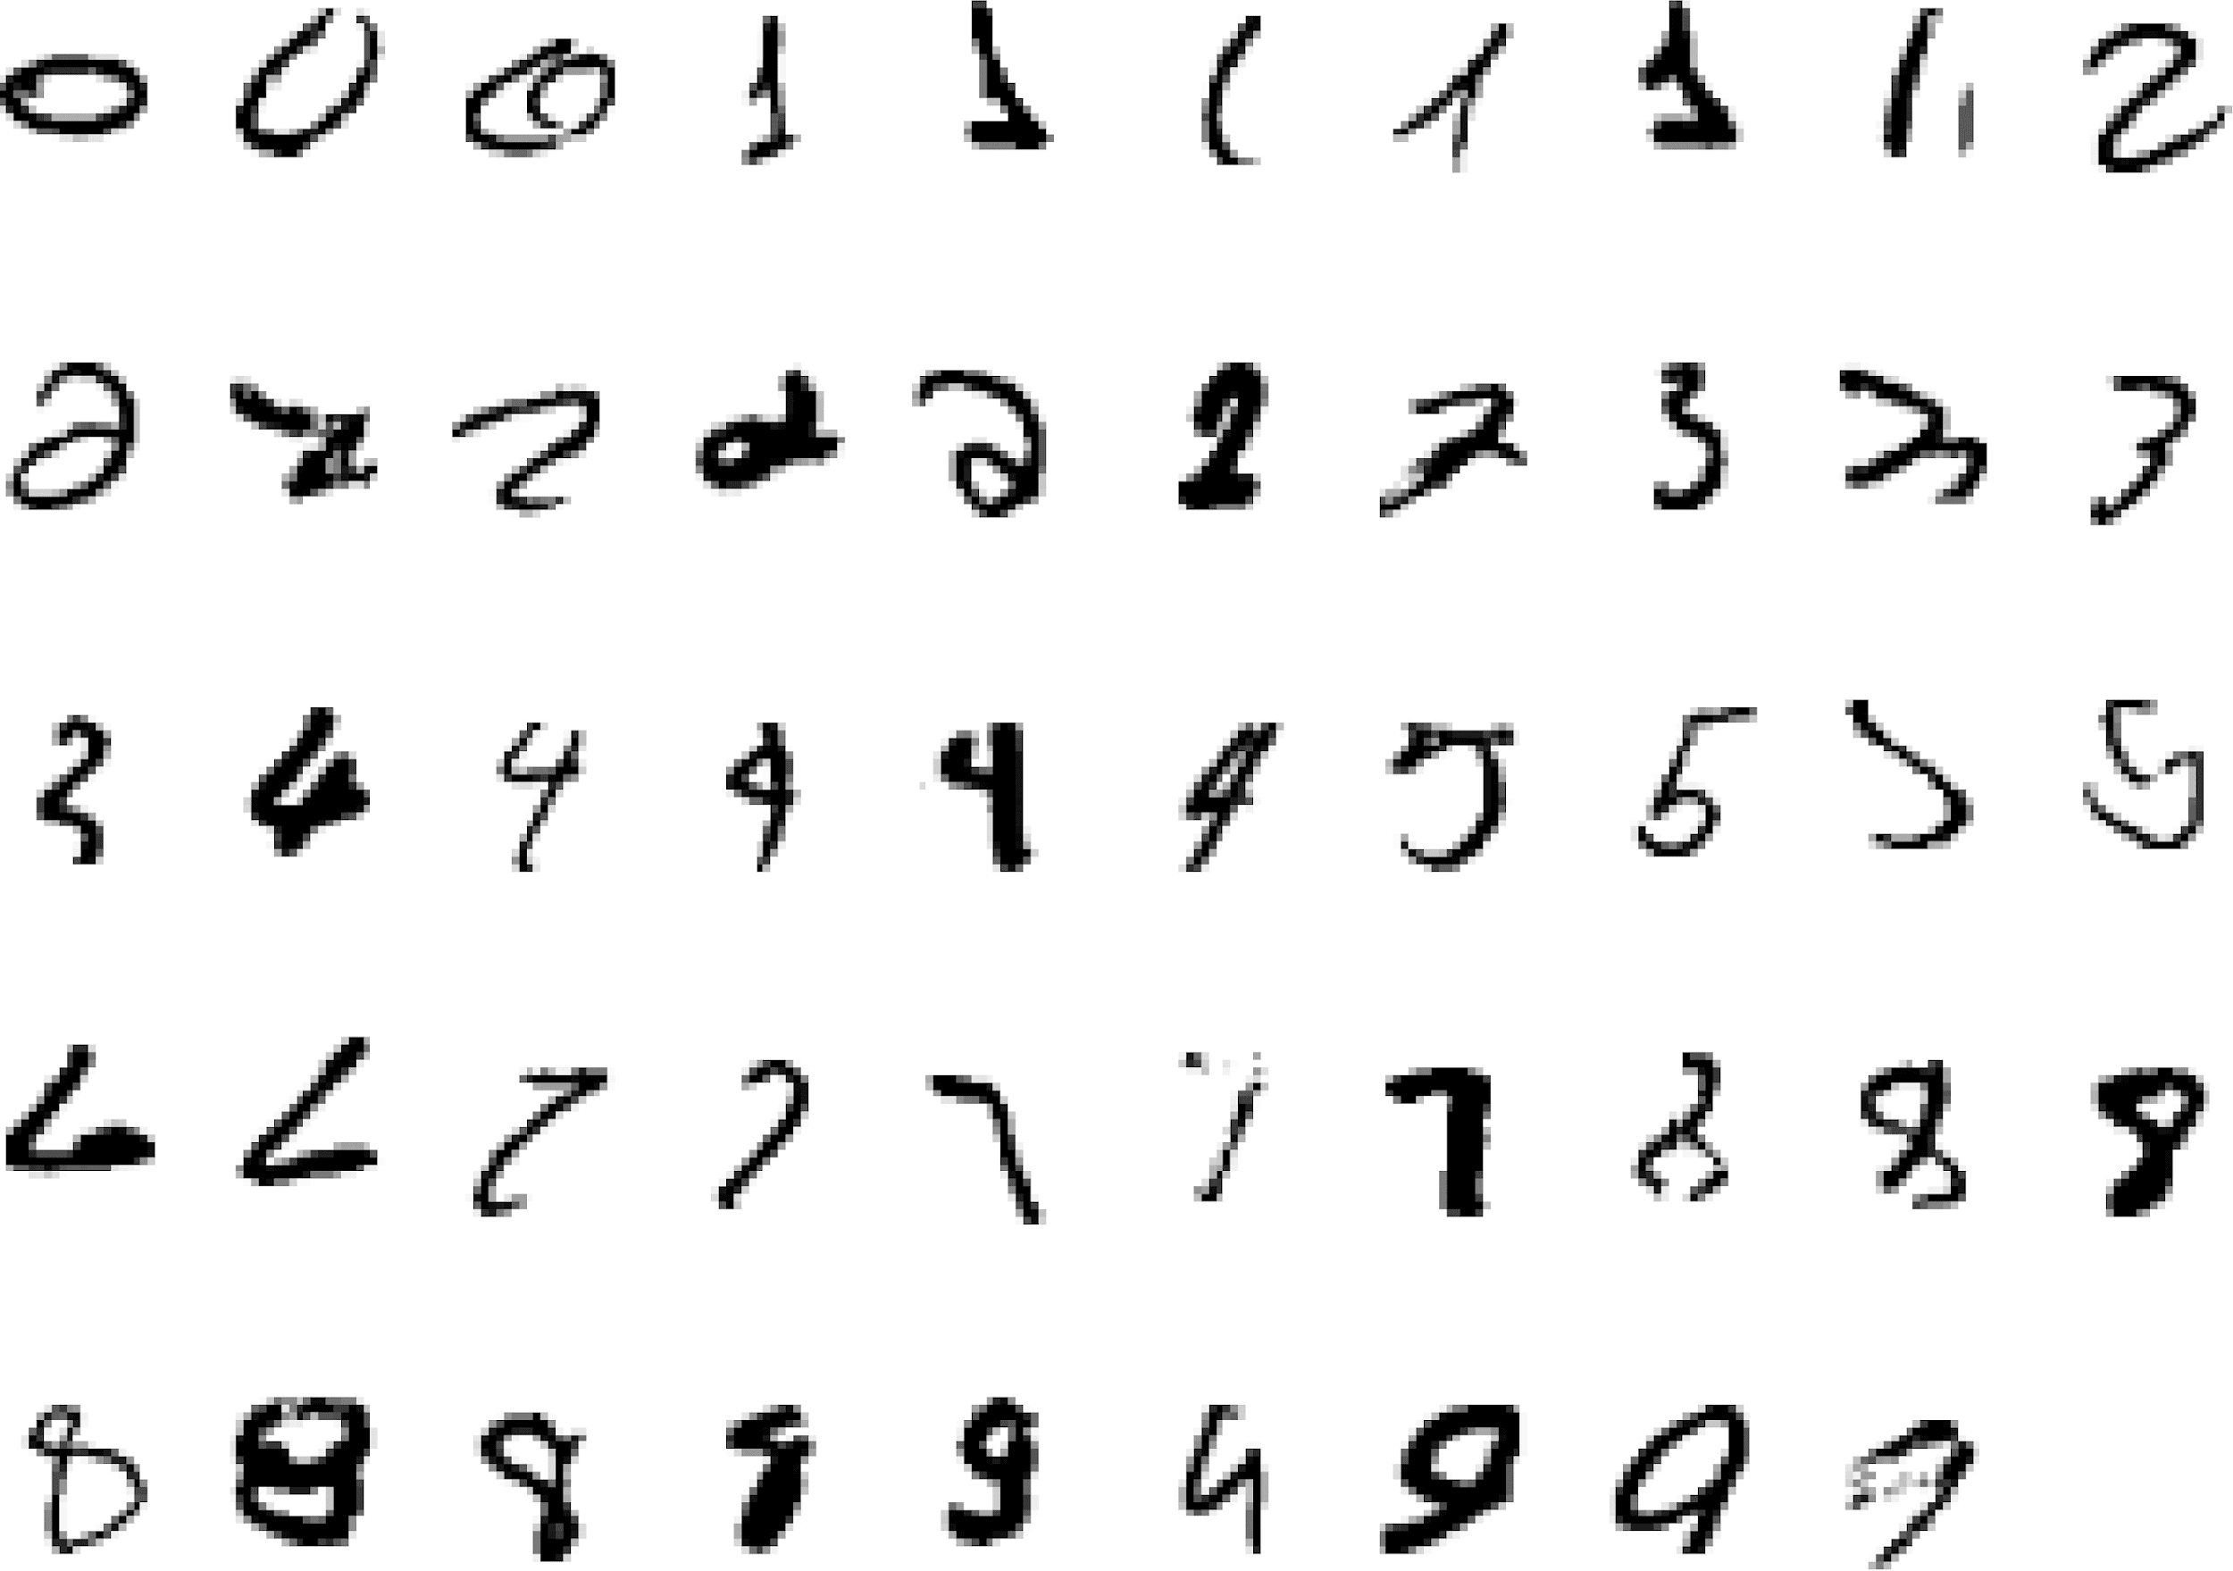
It is very hard to say what makes a 2
Pattern recognition
Slide credit: Geoffrey Hinton

Slide 26
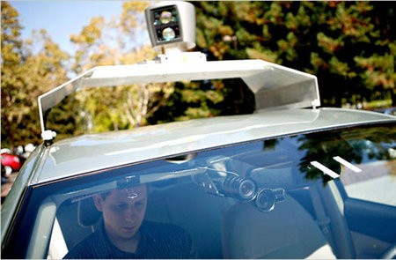
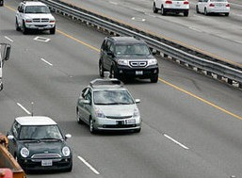
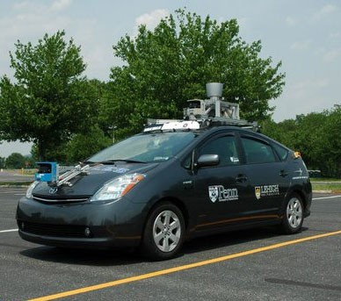
Autonomous Cars
Nevada made it legal for autonomous cars to drive on roads in June 2011
As of 2013, four states (Nevada, Florida, California, and Michigan) have legalized autonomous cars
UPenn’s Autonomous Car →
Slide credit: Eric Eaton

Slide 27
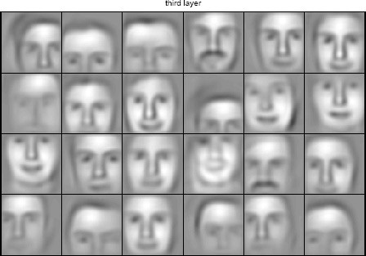
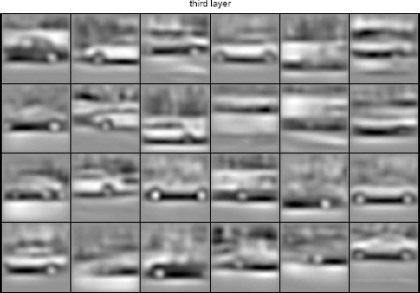
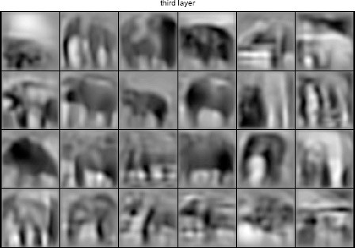
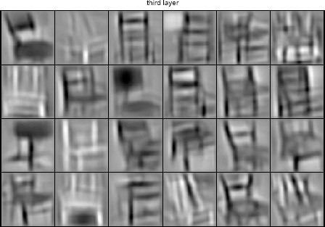
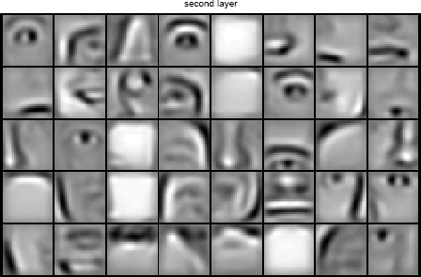
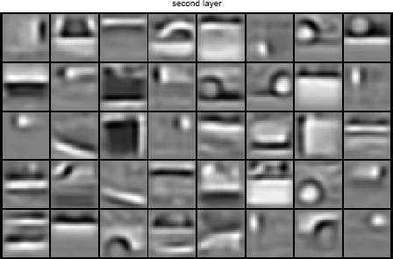
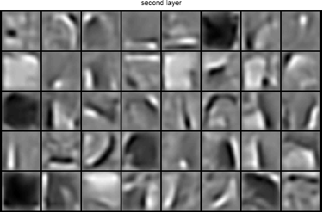
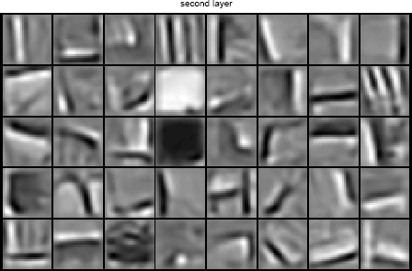
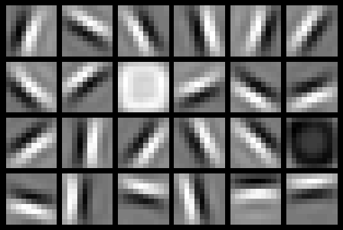
Learning of Object Parts
Slide credit: Andrew Ng

Slide 28
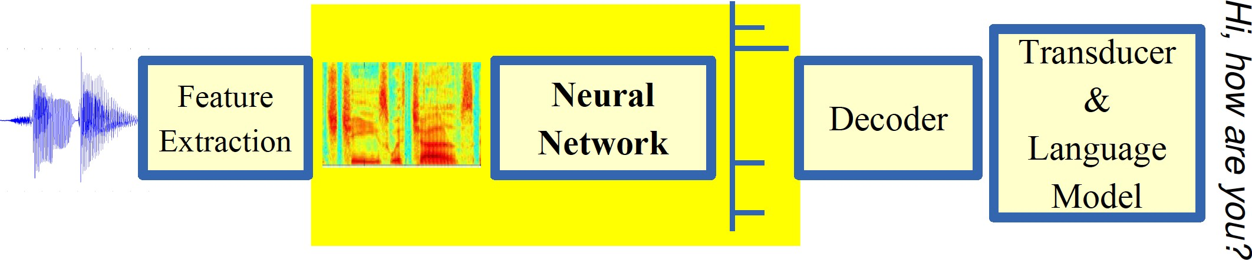
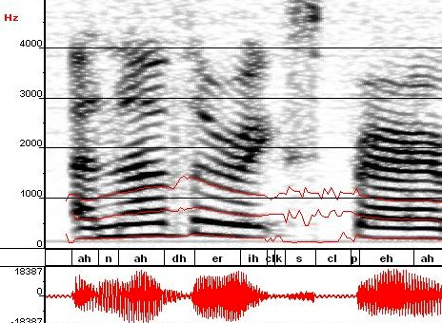
Automatic Speech Recognition
ML used to predict phoneme states from sound spectrogram Deep Learning Based Results
# Hidden Layers | 1 | 2 | 4 | 8 | 10 | 12
Word Error Rate % | 16.0 | 12.8 | 11.4 | 10.9 | 11.0 | 11.1
Baseline Gaussian Mixture Model based word error rate = 15.4%
[Zeiler et al. “On rectified linear units for speech recognition” ICASSP 2013]
Slide credit: Eric Eaton

Slide 29

Robotics

Slide 30
Types of Learning
Supervised (inductive) learning
Given: training data, desired outputs (labels)
Unsupervised learning
Given: training data (without desired outputs)
Semi-supervised learning
Given: training data + a few desired outputs
Reinforcement learning
Given: rewards from sequence of actions
Slide Credit: Eric Eaton

Slide 31




Supervised Learning: Regression
Given (x₁, y₁), (x₂, y₂), ..., (x_{n}, y_{n})
Learn a function f(x) to predict y given x
9
8
7
6
5
4
3
2
1
0
1970 1980
September Arctic Sea Ice Extent (1,000,000 sq km)
1990
Year
2000
2010
2020
Data from G. Witt. Journal of Statistics Education, Volume 21, Number 1 (2013) Slide Credit: Eric Eaton

Slide 32
Regression
y = f(x)
Training: given a training set of labeled examples {(x₁,y₁), …, (x_{N},y_{N})}, estimate the prediction function f by minimizing the prediction error on the training set
Testing: apply f to a never before seen test example x and output the predicted value y = f(x)
output
prediction function
features
Slide credit: L. Lazebnik

Slide 33
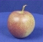
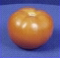
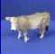
Classification Example
Apply a prediction function to a feature representation of the image to get the desired output:
f( ) = “apple”
f( ) = “tomato”
f( ) = “cow”
Slide credit: L. Lazebnik

Slide 34


















Supervised Learning: Classification
Given (x₁, y₁), (x₂, y₂), ..., (x_{n}, y_{n})
Learn a function f(x) to predict y given x
– y is categorical == classification
Breast Cancer (Malignant / Benign)
1(Malignant)
0(Benign)
Tumor Size
^{Predict Benign} Predict Malignant
Tumor Size
Slide Credit: Eric Eaton

Slide 35

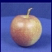
Classification
Training
Training Labels
Training Images
Features
Training
Learned model
Testing
Features
Learned model
Prediction
Test Image
Slide credit: D. Hoiem and L. Lazebnik

Slide 36















Unsupervised Learning
Given x₁, x₂, ..., x_{n} (without labels)
Output hidden structure behind the x’s
– E.g., clustering
Slide Credit: Eric Eaton

Slide 37

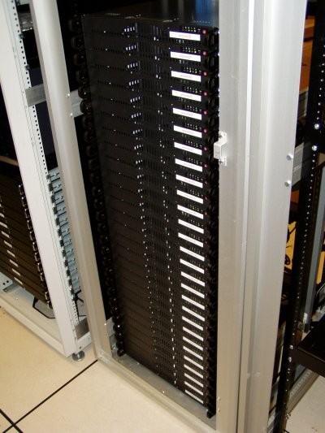
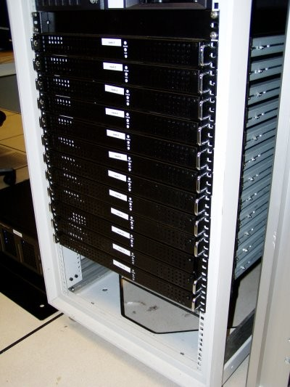



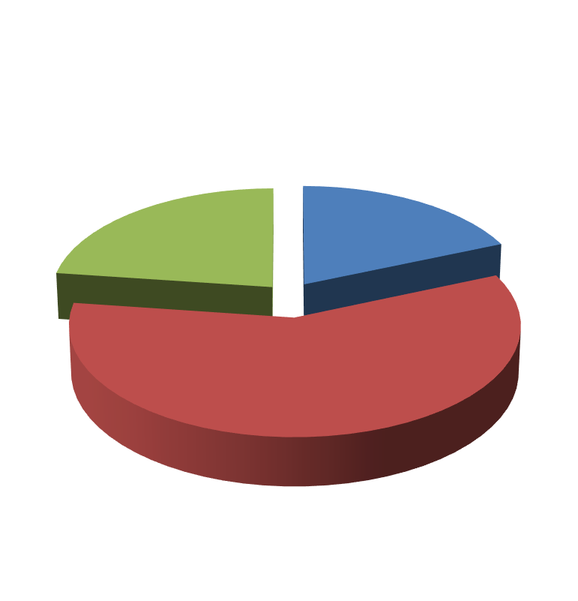

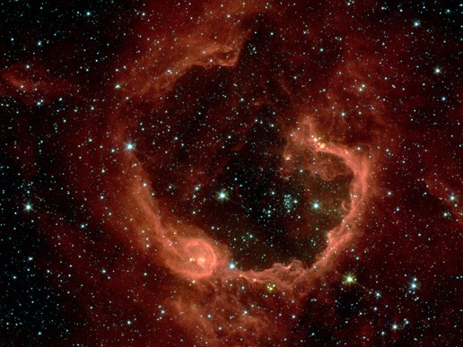


Unsupervised Learning
Organize computing clusters
Social network analysis
Market segmentation
Slide credit: Andrew Ng
Image credit: NASA/JPL-Caltech/E. Churchwell (Univ. of Wisconsin, Madison)
Astronomical data analysis

Slide 38
Reinforcement Learning
No predefined data
Semi-supervised learning model in machine learning,
Allow an agent to take actions and interact with an environment so as to maximize the total rewards.
Examples:
Resources management in computer clusters
Game playing
Robot in a maze
Slide Credit: Eric Eaton
Notes:
Reinforcement vs. Unsupervised Learning: Reinforcement Learning basically has a mapping structure that guides the machine from input to output. However, Unsupervised Learning has no such features present in it. In Unsupervised Learning, the machine focuses on the underlying task of locating the patterns rather than the mapping for progressing towards the end goal. For example, if the task for the machine is to suggest a good news update to a user, a Reinforcement Learning algorithm will look to get regular feedback from the user in question, and would then through the feedback build a reputable knowledge graph of all news related articles that the person may like. On the contrary, an Unsupervised Learning algorithm will try looking at many other articles that the person has read, similar to this one, and suggest something that matches the user’s preferences.

Slide 39
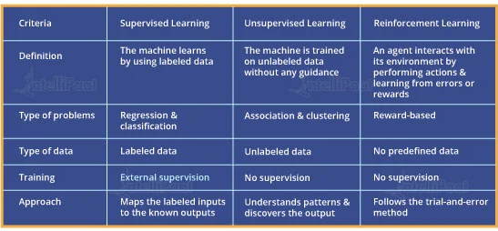
Supervised, Unsupervised and Reinforcement Learning Comparison

Slide 40
Open source ML programming tools
 | Platform |  | Algorithms or Features
Scikit Learn | Linux, Mac OS, Windows | Python, C, C++ | Classification, Regression, Clustering Preprocessing, Model Selection Dimensionality reduction.
PyTorch | Linux, Mac OS, Windows | Python, C++ | Autograd Module, Optimization Module NN Module
TensorFlow | Linux, Mac OS, Windows | Python, C++ | Provides a library for dataflow programming.
Weka | Linux, Mac OS, Windows | Java | Data preparation, Classification Regression, Clustering, Visualization Association rules mining

Slide 41
Open source ML programming tools
Colab | Cloud Service | - | Supports libraries of PyTorch, Keras, TensorFlow, and OpenCV
Apache Mahout | Cross-platform | Java Scala | Preprocessors,Regression Clustering, Recommenders Distributed Linear Algebra.
Accors.Net | Cross-platform | C# | Classification, Regression, Distribution Clustering, Hypothesis Tests & Kernel Methods, Image, Audio & Signal & Vision
Shogun | Windows Linux, UNIX Mac OS | C++ | Regression, Classification, Clustering Support vector machines. Dimensionality reduction, Online learning etc.
Keras.io | Cross-platform | Python | API for neural networks

Slide 42


Slide 43
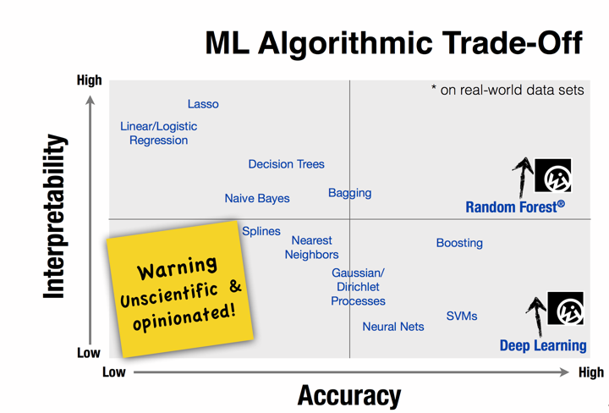

Slide 44
Design a Learning System

Slide 45






Designing a Learning System
Choose the training experience(data)
Choose exactly what is to be learned
– i.e. the target function
Choose how to represent the target function
Choose a learning algorithm to infer the target function from the experience
Training data
Learner
Environment/ Experience
Knowledge
Testing data
Performance Element
Slide Credit: Ray Mooney

Slide 46
Designing a Learning System: An Example
1. Problem Description (Ex: Playing checkers)
2. Choosing the Training Experience (data expressed as features)
3. Choosing the Target Function to be learnt (Ex: deciding next board position
4. Choosing a Representation for the Target Function (design a function as linear etc)
5. Choosing a Function Approximation Algorithm (parameters learning using loss function)
6. Final Design

Slide 47
Designing a Learning System: An Example
1. Problem Description (Ex: Playing checkers)
2. Choosing the Training Experience (data expressed as features)
3. Choosing the Target Function to be learnt (Ex: deciding next board position
4. Choosing a Representation for the Target Function (design a function as linear etc)
5. Choosing a Function Approximation Algorithm (parameters learning using loss function)
6. Final Design

Slide 48
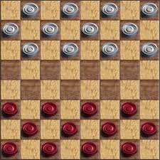
Choosing the training experience
In learning to play checkers, the system might learn from direct training examples consisting of individual checkers board states and the correct move for each.
Alternatively, it might have available only indirect information consisting of the move sequences and final outcomes of various games played.

Slide 49
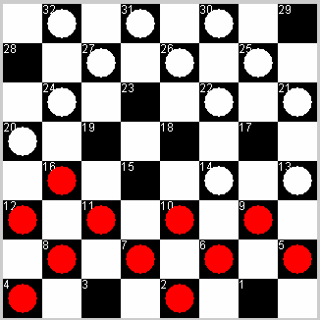
1) Choose the training experience
Direct
16 → 19

Slide 50
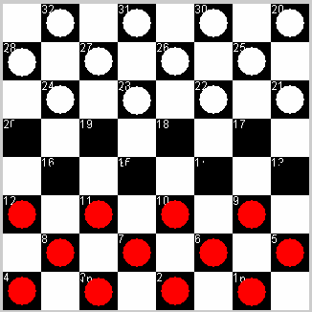
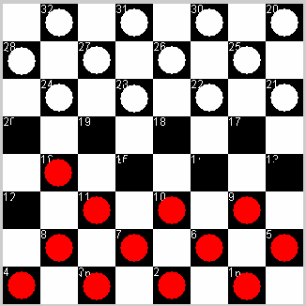
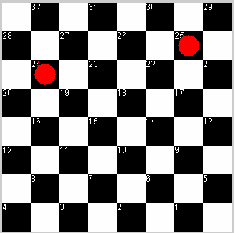
1) Choose the training experience
Indirect
WIN
Credit Assignment Problem!

Slide 51

1) Choose the training experience
•
Self-play experiments
•
No need for trainer.

Slide 52
2) Choose the target function
•
ChooseMove(B) → M
ChooseMove
= 16 → 19
Difficult, given our training experience

Slide 53
2) Choose the target function
•
V(b) → R
– Where V is an evaluation function that maps board, b, to some real number R.
V
= 30 points
Easier to learn

Slide 54
2) Choose the target function
12 → 16, or
For all legal moves:
=
11 →15, or
LegalMoves
….
- simulate that move
SimulateMove
12->16 =
- check the value of the result
V
= 30 points
Pick the best move

Slide 55
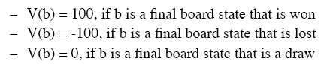
2) Choose the target function
•
What values should the target function, V, produce?
…but what about boards in the middle of a game?

Slide 56
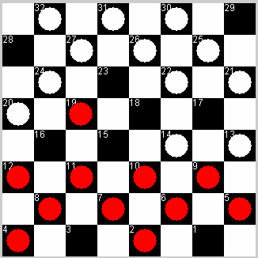
2) Choose the target function
….
b ‘
b
successor( b )
….
V(b’)=100
….
Not efficiently computable!

Slide 57
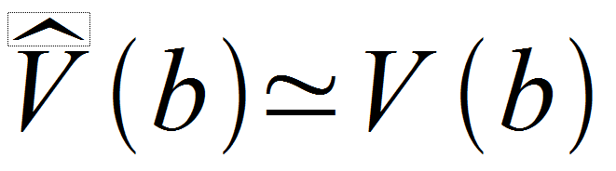
2) Choose the target function
•
•
V is too hard to learn
Function approximation
– Learn an approximation to ideal target function
V

Slide 58
3) Choose a representation
1) big table?
input: board
score
 | 50
 | 90
….

Slide 59
3) Choose a representation
2) CLIPS rules?
IF my piece is near a side edge THEN score = 80
IF my piece is near the opponents edge THEN score = 90
….

Slide 60
3) Choose a representation
3) polynomial function? we define some variables…
X₁ = number of white pieces on board X₂ = number of red pieces
X₃ = number of white kings X₄ = number of red kings
X₅ = number of white pieces threatened by red (can be captured on red’s next turn)
X₆ = number of red pieces threatened by white
e.g.
X₁ = 12
X₂ = 11
X₃ = 0
X₄ = 0
X₅ = 1
X₆ = 0

Slide 61
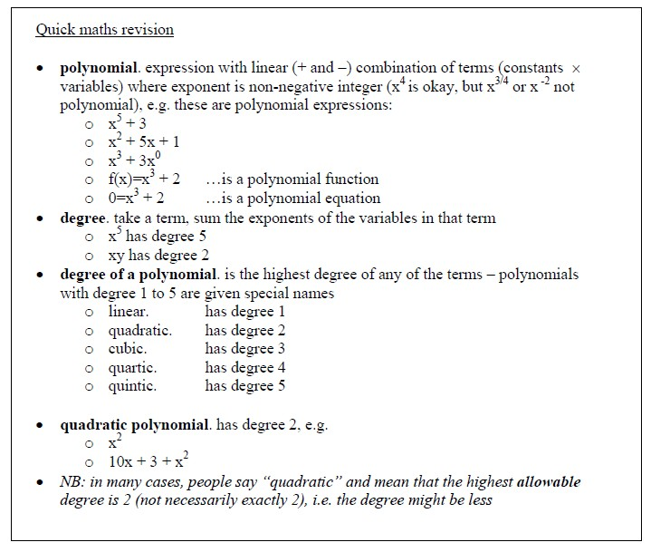
3) Choose a representation

Slide 62
3) Choose a representation
- Weighted linear combination:
Computer program will change the values of the weights – it will learn what the weights should be to give correct score for each board

Slide 63
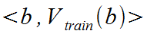
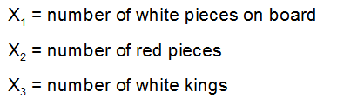
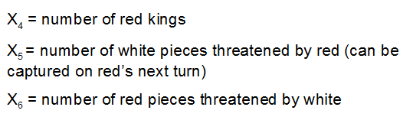
4) Choose a function approximation algorithm
•
•
•
Require a set of training examples Ordered pair:
e.g.
– Black has won (red has no pieces left):

Slide 64
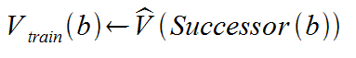
4) Choose a function approximation algorithm
•
What about intermediate board states?
Where Successor(b) is the next board state following b, which it is again the program's turn to move (i.e. the board state following the program's move and the opponents response)

Slide 65
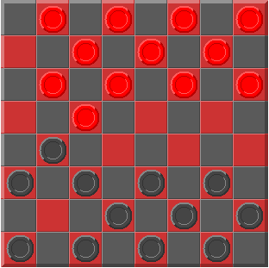
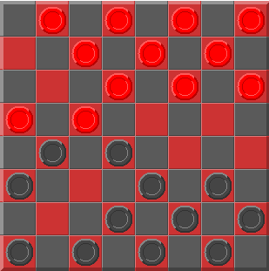
4) Choose a function approximation algorithm
•
b:
•
Successor(b):

Slide 66
4) Choose a function approximation algorithm
•
•
Now, we have the training data
Need an algorithm to adjust the weights to
best fit this training data.
Common approach: best set of weights will minimise the squared error, E, between training values and value predicted by
•

Slide 67
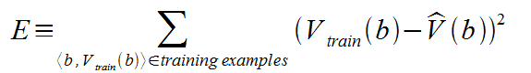
4) Choose a function approximation algorithm
- We wish to minimise E, for the observed training examples

Slide 68
4) Choose a function approximation algorithm
•
Need algorithm that will incrementally refine weights as more training examples become available
Needs to be robust to errors in training data
LMS training rule: will adjust weights a small amount in the direction that reduces the error
•
•

Slide 69
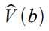
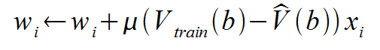
4) Choose a function approximation algorithm
•
LMS weight update rule.
– For each training example <b, V_{train}(b)>
•
•
Use the current weights to calculate
For each weight w_{i}, update it as
where,

Slide 70
4) Choose a function approximation algorithm
error
weight to update
learning rate
modify weight in proportion to size of attribute value

Slide 71
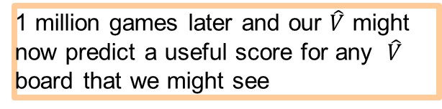
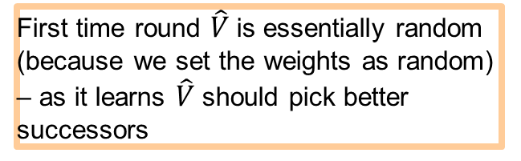
Final Algorithm
learning process – playing and learning at same time computer will play against itself
initialise with random weights (w = 23 etc.)
0
start a new game - for each board
calculate on all possible legal moves
pick the successor with the highest score
evaluate error
modify each weight to correct error
First time round $\hat{V}$is essentially random (because we set the weights as random) – as it learns $\hat{V}$should pick better successors
1 million games later and our $\hat{V}$ might now predict a useful score for any $\hat{V}$ board that we might see

Slide 72
Final Algorithm
(w₀ | = 25.0, w₁ | = 15.5, w₂ = 19.3, ..., w₆ = 54.4)
(w₀ | = 82.0, w₁ | = 15.3, w₂ = 9.9, ..., w₆ = 100.0)
(w₀ … | = 67.3, w₁ | = 0.5, w₂ = 3.5, ..., w₆ = 30.2)
(w₀ | = 3.23, w₁ | = 1.04, w₂ = 4.55, ..., w₆ = 0.78)
•
Searching hypothesis space for best fit to observed training data.

Slide 73
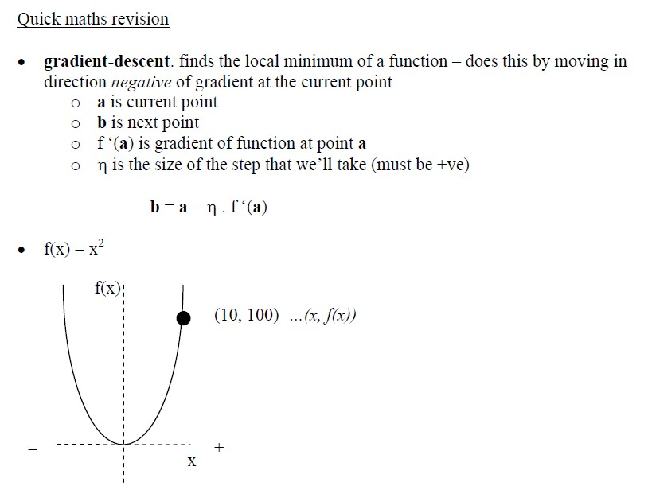

Slide 74


Slide 75


Slide 76
Final Design for Checkers Learning
The Performance Module (performance) : Takes as input a new board and outputs a trace of the game it played against itself.
The Critic (data generation) : Takes as input the trace of a game and outputs a set of training examples of the target function
The Generalizer (learner): Takes as input training examples and outputs a hypothesis which estimates the target function.
The Experiment Generator (task): Takes as input the current hypothesis (currently learned function) and outputs a new problem (an initial board state) for the performance system to explore

Slide 77
ML in a Nutshell
Tens of thousands of machine learning algorithms
Hundreds new every year
Every ML algorithm has three components
Representation
Optimization
Evaluation
Slide credit: Pedro Domingos

Slide 78
Evaluation
Accuracy
Precision and recall
Squared error
Likelihood
Posterior probability
Cost / Utility
Margin
Entropy
etc.
Slide credit: Pedro Domingos

Slide 79
Evaluating Performance
If y is discrete:
Accuracy: # correctly classified / # all test examples
Precision/recall
True Positive, False Positive, True Negative, False Negative
Precision = TP / (TP + FP) = # predicted true pos / # predicted pos
Recall = TP / (TP + FN) = # predicted true pos / # true pos
F-measure
= 2PR / (P + R)
Want evaluation metric to be in some range, e.g. [0 1]
0 = worst possible classifier, 1 = best possible classifier
Notes:
Diagnosis example

Slide 80

Evaluating Performance
If y is continuous:
Sum-of-Squared-Differences (SSD) error between predicted and true y:

Slide 81
Issues in Machine Learning
What algorithms are available for learning a concept? How well do they perform?
How much training data is sufficient to learn a concept with high confidence?
When is it useful to use prior knowledge?
Are some training examples more useful than others?
What are the best tasks for a system to learn?
What is the best way for a system to represent its knowledge?

Slide 82
Training vs Testing
What do we want?
High accuracy on training data?
No, high accuracy on unseen/new/test data!
Why is this tricky?
Training data
Features (x) and labels (y) used to learn mapping f
Test data
Features used to make a prediction
Labels only used to see how well we’ve learned f!!!
Validation data
Held-out set of the training data
Can use both features and labels to tune parameters of the model we’re learning
Slide Credit: Adriana Kovashka

Slide 83
Training vs. Test Distribution
We generally assume that training and test examples are independently drawn from the same overall distribution of data
– We call this “i.i.d” which stands for “independent and identically distributed”
Slide credit: Ray Mooney

Slide 84


ML in Practice
Understand domain, prior knowledge, and goals
Data integration, selection, cleaning, pre-processing, etc.
Learn models
Interpret results
Consolidate and deploy discovered knowledge
Loop
Based on a slide by Pedro Domingos

Slide 85
Recommended Readings
Tom M. Mitchell, Machine Learning, The McGraw-Hill Companies, Inc. International Edition 1997. [Ch. 1]
http://www.cs.princeton.edu/courses/archive/spr08/cos511/ [Web]
https://www.softwaretestinghelp.com/machine-learning-tools/

Slide 86
END of Session 1

Slide 87
Machine Learning ZG565
Dr. Sugata Ghosal
Sugata.ghosal@pilani.bits-pilani.ac.in

Slide 88
Session 2
Date – 27th May 2023
Time – 2 PM to 4 PM
These slides are prepared by the instructor, with grateful acknowledgement of many others who made their course materials freely available online.

Slide 89
Session Content
Data - Types, Attributes
Data Quality
Data Preprocessing
Performance Metrics
Challenges of ML
Model Evaluation, Selection
Homework
Review Lab Capsule 1 from the “Machine Learning” Virtual Labs (accessible via elearn portal)

Slide 90
ML in a Nutshell
Tens of thousands of machine learning algorithms
Hundreds new every year
Every ML algorithm has three components
Data Representation
Parameter Optimization
Model Evaluation, Selection
Slide credit: Pedro Domingos

Slide 91
ML in Practice
Understand domain, prior knowledge, and goals
Data integration, selection, cleaning, pre-processing, etc.
Learn optimal parameter of the models
Interpret results
Consolidate and deploy discovered knowledge
Loop
Based on a slide by Pedro Domingos

Slide 92
Definition of Data
Collection of data objects and their attributes
An attribute is a property or characteristic of an object
Examples: eye color of a person, temperature, etc.
aka variable, field, characteristic, dimension, or feature
A collection of attributes describe an object
Object is also known as record, point, case, sample, entity, or instance
Attributes
Objects

Slide 93
Attribute Values
Attribute values are numbers or symbols assigned to an attribute for a particular object
Distinction between attributes and attribute values
Same attribute can be mapped to different attribute values
Example: height can be measured in feet or meters
Different attributes can be mapped to the same set of values
Example: Attribute values for ID and age are integers
But properties of attribute can be different than the properties of the values used to represent the attribute

Slide 94
Types of Attributes
There are different types of attributes
Nominal
Examples: ID numbers, zip codes
Ordinal
Examples: rankings (e.g., taste of potato chips on a scale from 1-10), grades, height {tall, medium, short}
Interval
Examples: calendar dates, temperatures in Celsius or Fahrenheit.
Ratio
Examples: temperature in Kelvin, length, counts, elapsed time (e.g., time to run a race)

Slide 95
Properties of Attribute Values
The type of an attribute depends on which of the following properties/operations it possesses:
Distinctness: = ≠
Order: < >
Differences are + - meaningful :
Ratios are * / meaningful
Nominal attribute: distinctness
Ordinal attribute: distinctness & order
Interval attribute: distinctness, order & meaningful differences
Ratio attribute: all 4 properties/operations

Slide 96
Difference Between Ratio and Interval
Is it physically meaningful to say that a temperature of 10 ° is twice that of 5° on
the Celsius scale?
the Fahrenheit scale?
the Kelvin scale?
Consider measuring the height above average
If Bill’s height is three inches above average and Bob’s height is six inches above average, then would we say that Bob is twice as tall as Bill?
Is this situation analogous to that of temperature?

Slide 97
This categorization of attributes is due to S. S. Stevens

Slide 98
This categorization of attributes is due to S. S. Stevens

Slide 99
Discrete and Continuous Attributes
Discrete Attribute
Has only a finite or countably infinite set of values
Examples: zip codes, counts, or the set of words in a collection of documents
Often represented as integer variables.
Note: binary attributes are a special case of discrete attributes
Continuous Attribute
Has real numbers as attribute values
Examples: temperature, height, or weight.
Practically, real values can only be measured and represented using a finite number of digits.
Continuous attributes are typically represented as floating-point variables.

Slide 100
Asymmetric Attributes
Only presence (a non-zero attribute value) is regarded as important
Words present in documents
Items present in customer transactions
If we met a friend in the grocery store would we ever say the following? “I see our purchases are very similar since we didn’t buy most of the same things.”

Slide 101
Key Messages for Attribute Types
The types of operations you choose should be “meaningful” for the type of data you have
Distinctness, order, meaningful intervals, and meaningful ratios are only four (among many possible) properties of data
The data type you see – often numbers or strings – may not capture all the properties or may suggest properties that are not present
Analysis may depend on these other properties of the data
Many statistical analyses depend only on the distribution
In the end, what is meaningful can be specific to domain

Slide 102
Important Characteristics of Data
Dimensionality (number of attributes)
High dimensional data brings a number of challenges
Sparsity
Only presence counts
Resolution
Patterns depend on the scale
Size
Type of analysis may depend on size of data

Slide 103
Types of data sets
Record
Data Matrix
Document Data
Transaction Data
Graph
World Wide Web
Molecular Structures
Ordered
Spatial Data
Temporal Data
Sequential Data
Genetic Sequence Data

Slide 104
Record Data
Data that consists of a collection of records, each of which consists of a fixed set of attributes

Slide 105
Data Matrix
If data objects have the same fixed set of numeric attributes, then the data objects can be thought of as points in a multi-dimensional space, where each dimension represents a distinct attribute
Such a data set can be represented by an m by n matrix, where there are m rows, one for each object, and n columns, one for each attribute

Slide 106
Document Data
Each document becomes a ‘term’ vector
Each term is a component (attribute) of the vector
The value of each component is the number of times the corresponding term occurs in the document.

Slide 107
Transaction Data
A special type of data, where
Each transaction involves a set of items.
For example, consider a grocery store. The set of products purchased by a customer during one shopping trip constitute a transaction, while the individual products that were purchased are the items.
Can represent transaction data as record data

Slide 108
Graph Data
Examples: Generic graph, a molecule, and webpages
Benzene Molecule: C6H6

Slide 109

Ordered Data
Sequences of transactions
Items/Events
An element of the sequence

Slide 110
Ordered Data
Genomic sequence data

Slide 111

Ordered Data
Spatiotemporal Data
Average Monthly Temperature of land and ocean

Slide 112
Data Quality
Poor data quality negatively affects many data processing efforts
ML example: a classification model for detecting people who are loan risks is built using poor data
Some credit-worthy candidates are denied loans
More loans are given to individuals that default

Slide 113
Data Quality …
What kinds of data quality problems?
How can we detect problems with the data?
What can we do about these problems?
Examples of data quality problems:
Noise and outliers
Wrong data
Fake data
Missing values
Duplicate data

Slide 114
Noise
For objects, noise is an extraneous object
For attributes, noise refers to modification of original values
Examples: distortion of a person’s voice when talking on a poor phone and “snow” on television screen
The figures below show two sine waves of the same magnitude and different frequencies, the waves combined, and the two sine waves with random noise
The magnitude and shape of the original signal is distorted

Slide 115

Outliers
Outliers are data objects with characteristics that are considerably different than most of the other data objects in the data set
Case 1: Outliers are noise that interferes with data analysis
Case 2: Outliers are the goal of our analysis
Credit card fraud
Intrusion detection
Causes?

Slide 116
Missing Values
Reasons for missing values
Information is not collected (e.g., people decline to give their age and weight)
Attributes may not be applicable to all cases (e.g., annual income is not applicable to children)
Handling missing values
Eliminate data objects or variables
Estimate missing values
Example: time series of temperature
Example: census results
Ignore the missing value during analysis

Slide 117
Duplicate Data
Data set may include data objects that are duplicates, or almost duplicates of one another
Major issue when merging data from heterogeneous sources
Examples:
Same person with multiple email addresses
Data cleaning
Process of dealing with duplicate data issues

Slide 118
Data Preprocessing
Aggregation
Sampling
Discretization and Binarization
Attribute Transformation
Dimensionality Reduction
Feature subset selection
Feature creation

Slide 119

Aggregation
Combining two or more attributes (or objects) into a single attribute (or object)
Purpose
Data reduction - reduce the number of attributes or objects
Change of scale
Cities aggregated into regions, states, countries, etc.
Days aggregated into weeks, months, or years
More “stable” data - aggregated data tends to have less variability

Slide 120
Example: Precipitation in Australia
This example is based on precipitation in Australia from the period 1982 to 1993.
The next slide shows
A histogram for the standard deviation of average monthly precipitation for 3,030 0.5◦ by 0.5◦ grid cells in Australia, and
A histogram for the standard deviation of the average yearly precipitation for the same locations.
The average yearly precipitation has less variability than the average monthly precipitation.
All precipitation measurements (and their standard deviations) are in centimeters.

Slide 121


Example: Precipitation in Australia (contd)
Variation of Precipitation in Australia
Standard Deviation of Average Monthly Precipitation
Standard Deviation of Average Yearly Precipitation

Slide 122
Sampling
Sampling is the main technique employed for data reduction.
It is often used for both the preliminary investigation of the data and the final data analysis.
Statisticians often sample because obtaining the entire set of data of interest is too expensive or time consuming.
Sampling is typically used in data mining because processing the entire set of data of interest is too expensive or time consuming.

Slide 123
Sampling …
The key principle for effective sampling is the following:
Using a sample will work almost as well as using the entire data set, if the sample is representative
A sample is representative if it has approximately the same properties (of interest) as the original set of data

Slide 124



Sample Size
8000 points 2000 Points 500 Points

Slide 125

Issues with Subsampling (Independence Violation)
IRIS Dataset of Flowers
50 Setosa, 50 Versicolor, and 50 Virginica
Random subsampling can assign 2/3 (100) to training set and 1/3 (50) to the test set
Training set → 38 x Setosa, 28 x Versicolor, 34 x Virginica
Test set → 12 x Setosa, 22 x Versicolor, 16 x Virginica

Slide 126
Types of Sampling
Simple Random Sampling
There is an equal probability of selecting any particular item
Sampling without replacement
As each item is selected, it is removed from the population
Sampling with replacement
Objects are not removed from the population as they are selected for the sample.
In sampling with replacement, the same object can be picked up more than once
Stratified sampling
Split the data into several partitions; then draw random samples from each partition

Slide 127
Building Classifiers with Imbalanced Training Set
Modify the distribution of training data so that rare class is well-represented in training set
Undersample the majority class
Oversample the rare class

Slide 128

Sample Size
What sample size is necessary to get at least one object from each of 10 equal-sized groups.

Slide 129
Discretization
Discretization is the process of converting a continuous attribute into an ordinal attribute
A potentially infinite number of values are mapped into a small number of categories
Discretization is used in both unsupervised and supervised settings

Slide 130

Unsupervised Discretization
Data consists of four groups of points and two outliers. Data is one-dimensional, but a random y component is added to reduce overlap.

Slide 131

Unsupervised Discretization
Equal interval width approach used to obtain 4 values.

Slide 132

Unsupervised Discretization
Equal frequency approach used to obtain 4 values.

Slide 133

Unsupervised Discretization
K-means approach to obtain 4 values.

Slide 134
Discretization in Supervised Settings
Many classification algorithms work best if both the independent and dependent variables have only a few values
We give an illustration of the usefulness of discretization using the following example.

Slide 135
Binarization
Binarization maps a continuous or categorical attribute into one or more binary variables

Slide 136
Attribute Transformation
An attribute transform is a function that maps the entire set of values of a given attribute to a new set of replacement values such that each old value can be identified with one of the new values
Simple functions: x^{k}, log(x), e^{x}, |x|
Normalization
Refers to various techniques to adjust to differences among attributes in terms of frequency of occurrence, mean, variance, range
Take out unwanted, common signal, e.g., seasonality
In statistics, standardization refers to subtracting off the means and dividing by the standard deviation

Slide 137

Example: Sample Time Series of Plant Growth
Minneapolis
Net Primary Production (NPP) is a measure of plant growth used by ecosystem scientists.
Correlations between time series
Correlations between time series

Slide 138

Seasonality Accounts for Much Correlation
Minneapolis
Normalized using monthly Z Score:
Subtract off monthly mean and divide by monthly standard deviation
Correlations between time series
Correlations between time series

Slide 139

Curse of Dimensionality
When dimensionality increases, data becomes increasingly sparse in the space that it occupies
Definitions of density and distance between points, which are critical for clustering and outlier detection, become less meaningful
Randomly generate 500 points
Compute difference between max and min distance between any pair of points

Slide 140
Dimensionality Reduction
Purpose:
Avoid curse of dimensionality
Reduce amount of time and memory required by data mining algorithms
Allow data to be more easily visualized
May help to eliminate irrelevant features or reduce noise
Techniques
Principal Components Analysis (PCA)
Singular Value Decomposition
Others: supervised and non-linear techniques

Slide 141
Feature Subset Selection
Another way to reduce dimensionality of data
Redundant features
Duplicate much or all of the information contained in one or more other attributes
Example: purchase price of a product and the amount of sales tax paid
Irrelevant features
Contain no information that is useful for the data mining task at hand
Example: students' ID is often irrelevant to the task of predicting students' GPA
Many techniques developed, especially for classification

Slide 142
Feature Creation
Create new attributes that can capture the important information in a data set much more efficiently than the original attributes
Three general methodologies:
Feature extraction
Example: extracting edges from images
Feature construction
Example: dividing mass by volume to get density
Mapping data to new space
Example: Fourier and wavelet analysis

Slide 143


Mapping Data to a New Space
Fourier and wavelet transform
Frequency
Two Sine Waves + Noise
Frequency

Slide 144
Evaluation Metrics: Confusion Matrix
 | PREDICTED CLASS
ACTUAL CLASS |  | Class=Yes | Class=No
 | Class=Yes | a | b
 | Class=No | c | d
a: TP (true positive)
b: FN (false negative)
c: FP (false positive)
d: TN (true negative)

Slide 145
Evaluation Metrics: Accuracy
 | PREDICTED CLASS
ACTUAL CLASS |  | Class=Yes | Class=No
 | Class=Yes | a (TP) | b (FN)
 | Class=No | c (FP) | d (TN)
Most widely-used metric:

Slide 146
Class Imbalance Problem
Lots of classification problems where the classes are skewed (more records from one class than another)
Credit card fraud
Intrusion detection
Defective products in manufacturing assembly line
COVID-19 test results on a random sample
Key Challenge:
Evaluation measures such as accuracy are not well-suited for imbalanced class

Slide 147
Problem with Accuracy
Consider a 2-class problem
Number of Class NO examples = 990
Number of Class YES examples = 10
If a model predicts everything to be class NO, accuracy is 990/1000 = 99 %
This is misleading because this trivial model does not detect any class YES example
Detecting the rare class is usually more interesting (e.g., frauds, intrusions, defects, etc)
 | PREDICTED CLASS
ACTUAL CLASS |  | Class=Yes | Class=No
 | Class=Yes | 0 | 10
 | Class=No | 0 | 990

Slide 148
Which model is better?
 | PREDICTED
ACTUAL |  | Class=Yes | Class=No
 | Class=Yes | 0 | 10
 | Class=No | 0 | 990
A
Accuracy: 99%
 | PREDICTED
ACTUAL |  | Class=Yes | Class=No
 | Class=Yes | 10 | 0
 | Class=No | 500 | 490
B
Accuracy: 50%

Slide 149
Which model is better?
 | PREDICTED
ACTUAL |  | Class=Yes | Class=No
 | Class=Yes | 5 | 5
 | Class=No | 0 | 990
A
B
 | PREDICTED
ACTUAL |  | Class=Yes | Class=No
 | Class=Yes | 10 | 0
 | Class=No | 500 | 490

Slide 150
Alternative Measures
 | PREDICTED CLASS
ACTUAL CLASS |  | Class=Yes | Class=No
 | Class=Yes | a | b
 | Class=No | c | d

Slide 151
Alternative Measures
 | PREDICTED CLASS
ACTUAL CLASS |  | Class=Yes | Class=No
 | Class=Yes | 10 | 0
 | Class=No | 10 | 980

Slide 152
Alternative Measures
 | PREDICTED CLASS
ACTUAL CLASS |  | Class=Yes | Class=No
 | Class=Yes | 10 | 0
 | Class=No | 10 | 980
 | PREDICTED CLASS
ACTUAL CLASS |  | Class=Yes | Class=No
 | Class=Yes | 1 | 9
 | Class=No | 0 | 990

Slide 153
Which of these classifiers is better?
 | PREDICTED CLASS
ACTUAL CLASS |  | Class=Yes | Class=No
 | Class=Yes | 40 | 10
 | Class=No | 10 | 40
A
B
 | PREDICTED CLASS
ACTUAL CLASS |  | Class=Yes | Class=No
 | Class=Yes | 40 | 10
 | Class=No | 1000 | 4000

Slide 154

Measures of Classification Performance
 | PREDICTED CLASS
ACTUAL CLASS |  | Yes | No
 | Yes | TP | FN
 | No | FP | TN
α is the probability that we reject the null hypothesis when it is true. This is a Type I error or a false positive (FP).
β is the probability that we accept the null hypothesis when it is false. This is a Type II error or a false negative (FN).

Slide 155




Alternative Measures
A | PREDICTED CLASS
ACTUAL CLASS |  | Class=Yes | Class=No
 | Class=Yes | 40 | 10
 | Class=No | 10 | 40
$$\text{Precision} (p) =0.8 \\ \text{TPR} = \text{Recall} (r)=0.8 \\ \text{FPR} =0.2 \\ \text{F}\text{−}\text{measure} (F)=0.8 \\ \text{Accuracy} =0.8$$
$$\frac{TPR}{FPR}=4$$
B | PREDICTED CLASS
ACTUAL CLASS |  | Class=Yes | Class=No
 | Class=Yes | 40 | 10
 | Class=No | 1000 | 4000
$$\text{Precision} (p) =0.038 \\ \text{TPR} = \text{Recall} (r)=0.8 \\ \text{FPR} = \text{0}\text{.}\text{2} \\ \text{F}\text{−}\text{measure} (F)=0.07 \\ \text{Accuracy} =0.8$$
$$\frac{TPR}{FPR}=4$$

Slide 156
Which of these classifiers is better?
A | PREDICTED CLASS
ACTUAL CLASS |  | Class=Yes | Class=No
 | Class=Yes | 10 | 40
 | Class=No | 10 | 40
B | PREDICTED CLASS
ACTUAL CLASS |  | Class=Yes | Class=No
 | Class=Yes | 25 | 25
 | Class=No | 25 | 25
C | PREDICTED CLASS
ACTUAL CLASS |  | Class=Yes | Class=No
 | Class=Yes | 40 | 10
 | Class=No | 40 | 10

Slide 157
ROC (Receiver Operating Characteristic)
A graphical approach for displaying trade-off between detection rate and false alarm rate
Developed in 1950s for signal detection theory to analyze noisy signals
ROC curve plots TPR against FPR
Performance of a model represented as a point in an ROC curve

Slide 158

ROC Curve
(TPR,FPR):
(0,0): declare everything to be negative class
(1,1): declare everything to be positive class
(1,0): ideal
Diagonal line:
Random guessing
Below diagonal line:
prediction is opposite of the true class

Slide 159
ROC (Receiver Operating Characteristic)
To draw ROC curve, classifier must produce continuous-valued output
Outputs are used to rank test records, from the most likely positive class record to the least likely positive class record
By using different thresholds on this value, we can create different variations of the classifier with TPR/FPR tradeoffs
Many classifiers produce only discrete outputs (i.e., predicted class)
How to get continuous-valued outputs?
Decision trees, rule-based classifiers, neural networks, Bayesian classifiers, k-nearest neighbors, SVM

Slide 160

ROC Curve Example
1-dimensional data set containing 2 classes (positive and negative)
Any points located at x > t is classified as positive
At threshold t:
TPR=0.5, FNR=0.5, FPR=0.12, TNR=0.88

Slide 161
How to Construct an ROC curve
Use a classifier that produces a continuous-valued score for each instance
The more likely it is for the instance to be in the + class, the higher the score
Sort the instances in decreasing order according to the score
Apply a threshold at each unique value of the score
Count the number of TP, FP, TN, FN at each threshold
TPR = TP/(TP+FN)
FPR = FP/(FP + TN)
Instance | Score | True Class
1 | 0.95 | +
2 | 0.93 | +
3 | 0.87 | -
4 | 0.85 | -
5 | 0.85 | -
6 | 0.85 | +
7 | 0.76 | -
8 | 0.53 | +
9 | 0.43 | -
10 | 0.25 | +

Slide 162


How to construct an ROC curve
Threshold >=
ROC Curve:

Slide 163

Using ROC for Model Comparison
No model consistently outperforms the other
M₁ is better for small FPR
M₂ is better for large FPR
Area Under the ROC curve (AUC)
Ideal:
Area = 1
Random guess:
Area = 0.5

Slide 164
Dealing with Imbalanced Classes - Summary
Many measures exists, but none of them may be ideal in all situations
Random classifiers can have high value for many of these measures
TPR/FPR provides important information but may not be sufficient by itself in many practical scenarios
Given two classifiers, sometimes you can tell that one of them is strictly better than the other
C1 is strictly better than C2 if C1 has strictly better TPR and FPR relative to C2 (or same TPR and better FPR, and vice versa)
Even if C1 is strictly better than C2, C1’s F-value can be worse than C2’s if they are evaluated on data sets with different imbalances
Classifier C1 can be better or worse than C2 depending on the scenario at hand (class imbalance, importance of TP vs FP, cost/time tradeoffs)

Slide 165
Which Classifier is better?
T1 | PREDICTED CLASS
ACTUAL CLASS |  | Class=Yes | Class=No
 | Class=Yes | 50 | 50
 | Class=No | 1 | 99
T2 | PREDICTED CLASS
ACTUAL CLASS |  | Class=Yes | Class=No
 | Class=Yes | 99 | 1
 | Class=No | 10 | 90
T3 | PREDICTED CLASS
ACTUAL CLASS |  | Class=Yes | Class=No
 | Class=Yes | 99 | 1
 | Class=No | 1 | 99

Slide 166
Which Classifer is better? Medium Skew case
T1 | PREDICTED CLASS
ACTUAL CLASS |  | Class=Yes | Class=No
 | Class=Yes | 50 | 50
 | Class=No | 10 | 990
T2 | PREDICTED CLASS
ACTUAL CLASS |  | Class=Yes | Class=No
 | Class=Yes | 99 | 1
 | Class=No | 100 | 900
T3 | PREDICTED CLASS
ACTUAL CLASS |  | Class=Yes | Class=No
 | Class=Yes | 99 | 1
 | Class=No | 10 | 990

Slide 167
Which Classifer is better? High Skew case
T1 | PREDICTED CLASS
ACTUAL CLASS |  | Class=Yes | Class=No
 | Class=Yes | 50 | 50
 | Class=No | 100 | 9900
T2 | PREDICTED CLASS
ACTUAL CLASS |  | Class=Yes | Class=No
 | Class=Yes | 99 | 1
 | Class=No | 1000 | 9000
T3 | PREDICTED CLASS
ACTUAL CLASS |  | Class=Yes | Class=No
 | Class=Yes | 99 | 1
 | Class=No | 100 | 9900

Slide 168
Challenges of Machine Learning
Training Data
Insufficient
Non representative
Model Selection
Overfitting
Underfitting
Validation and Testing

Slide 169

Insufficient Training Data
Consider trade-off Between Algorithm development & training data capture

Slide 170

Non-representative Training Data
Training Data be representative of the new cases we want to generalize
Small sample size leads to sampling noise
Missing data over emphasizes the role of wealth on happiness
If sampling process is flawed, even large sample size can lead to sampling bias
missing data
available data

Slide 171
Data Quality
Cleaning often needed for improving data quality
Some instances have missing features
e.g., 5% of customers did not specify their age
Ignore the instances all together or the feature,
fill in the missing values
Some instances can be erroneous, noisy or outliers
Human or machine generated
Identify, discard or fix manually, as appropriate

Slide 172
Irrelevant Features
Feature engineering needed for coming up with a good set of features
Feature selection
more useful features to train on among existing features.
Feature extraction
combine existing features to produce a more useful one.
Create new features by gathering new data

Slide 173


Model Selection
Overfitting or Underfitting
Overfitting leads to high performance in training set but performs poorly on new data
e.g., a high-degree polynomial life satisfaction model that strongly overfits the training data
Small training set or sampling noise can lead to model following the noise than the underlying pattern in the dataset
Solution: Regularization to constrain the values of parameters
Underfitting when the model is too simple to learn the underlying structure in the data
Select a more powerful model, with more parameters
Feed better features to the learning algorithm
Reduce regularization
Large slope
High-order
polynomial
Smaller slope

Slide 174
Choice of Hyperparameters
Modern ML models often use a lot of model parameters
Known as hyperparameters
Model performance depends on choice of parameters
Each parameter can assume a number of values
Real numbers or categories
Exponential number of hyperparameter combinations possible
Best model correspond to best cross validation performance over the set of hyperparameter combinations
Expensive to perform
Some empirical frameworks available for hyperparameter optimization
Grid search
Random search
Bayesian

Slide 175
Evaluating Predictive Performance of a Model
Want to estimate the generalization performance, the predictive performance of our model on future (unseen) data.
Want to increase the predictive performance by tweaking the learning algorithm and selecting the best performing model from a given hypothesis space.
Want to identify the ML algorithm that is best-suited for the problem at hand; thus, we want to compare different algorithms, selecting the best-performing one as well as the best performing model from the algorithm’s hypothesis space.

Slide 176
Evaluation and Validation
Performance of ML algorithms is statistical / predictive
Good ML algorithms need to work well on test data
But test data is often not accessible to the provider of the algorithm
Common assumption is training data is representative of test data
Randomly chosen subset of the training data is held out as validation set, aka dev set
Once ML model is trained, its performance is evaluated on validation data
Expectation is ML model working well on validation set will work well on unknown test data
Typically 20-30% of the data is randomly held out as validation data

Slide 177
Cross Validation
K-fold validation is often performed
To reduce the bias of validation set selection process
Often K is chosen as 10
aka 10 fold cross validation
10 fold cross validation involves
randomly selecting the validation set 10 times
model generation with 10 resulting training set
Evaluate the performance of each on that validation set
averaging the performance over the validation sets

Slide 178
Training vs Testing
What do we want?
High accuracy on training data?
No, high accuracy on unseen/new/test data!
Why is this tricky?
Training data
Features (x) and labels (y) used to learn mapping f
Test data
Features used to make a prediction
Labels only used to see how well we’ve learned f!!!
Validation data
Held-out set of the training data
Can use both features and labels to tune parameters of the model we’re learning
Slide Credit: Adriana Kovashka

Slide 179
Training vs. Test Distribution
We generally assume that training and test examples are independently drawn from the same overall distribution of data
– We call this “i.i.d” which stands for “independent and identically distributed”
Slide credit: Ray Mooney

Slide 180

Holdout for Model Evaluation

Slide 181

Holdout for Model Selection (1)

Slide 182

Holdout for Model Selection (2)

Slide 183

Holdout for Model Selection (3)

Slide 184

K Fold Cross Validation (CV) for Model Evaluation

Slide 185

CV for Model Selection (1)

Slide 186

CV for Model Selection (2)

Slide 187
END of Session 2

Slide 188
Machine Learning AIML CLZG565
M3 : Linear Models for Regression
Dr. Sugata Ghosal
sugata.ghosal@pilani.bits-pilani.ac.in

Slide 189
Linear Regression

Slide 190


Inductive Learning Hypothesis : Interpretation
Target Concept
Discrete : f(x) $∈$ {Yes, No, Maybe}
Continuous : f(x) $∈$ [20-100]
Probability Estimation : f(x) $∈$ [0-1]
Classification
Regression

Slide 191
Formal Representation: Interpretation
Supervised Learning: Regression
GOAL : Previously unseen records should be assigned a value as accurately as possible.
Given (x₁, y₁), (x₂, y₂), ..., (x_{n}, y_{n})
Learn a function f (x) to predict y given x
– y is real-valued
9
8
7
6
5
4
3
2
1
0
1970 1980
September Arctic Sea Ice Extent (1,000,000 sq km)
1990
2000
2010
2020
Year Number

Slide 192



Machine Learning Process : Interpretation
Training Set
Price
(in 1000s of dollars)
Learning Algorithm
Size (feet²)
Size in feet² (x) | Price ($) in 1000's (y)
2104 | 460
1416 | 232
1534 | 315
852 | 178
… | …
Size of house
h
Estimated price
Hypothesis:
‘s : Parameters
h(.) : Model
How to choose ‘s ?

Slide 193


Types of Regression Models
simple regression model
(Education) x y (Income)
(Education) x₁
(Soft Skills) x₂
(Experience) x₃
(Age) x₄
multiple regression model
y (Income)

Slide 194

Learning the Model Parameters
Closed Form Solution Approach
Gradient Descent Approach

Slide 195


Linear Regression : Least Squares

Slide 196


Intuition Behind Cost Function
Source Credit :

Slide 197
Intuition Behind Cost Function
Source Credit :

Slide 198

Intuition Behind Cost Function

Slide 199

Intuition Behind Cost Function
Source Credit :

Slide 200

Maxima and Minima

Slide 201

Notion of Maxima and Minima of a function
In Machine Learning
CarPrice = 1 + 0.05Mileage
CarPrice = 1 + 0.25Mileage
CarPrice = 1 + 0.75Mileage
15.7
15.3
Weight of Mileage
Mileage (in kmpl) | Car Price (in cr)
9.8 | 10.48
9.12 | 1.75
9.5 | 6.95
10 | 2.51
12.4
Sum of absolute Error
/ Training Error

Slide 202



: Multivariate
Convex Function
Real-valued function defined on an n-dimensional interval is called convex if the line segment between any two points on the graph of the function lies above or on the graph

Slide 203
Closed Form Solution

Slide 204



Vectorization

Slide 205



Vectorization

Slide 206


Vectorization

Slide 207

Vectorization

Slide 208

Vectorization

Slide 209




Fit the Linear Regression Model :
Using Closed Form

Slide 210
Gradient Descent Approach

Slide 211

Intuition Behind Cost Function
Source Credit :

Slide 212

Intuition Behind Cost Function
Source Credit :

Slide 213

Basic Search Procedure
Source Credit : Figure by Andrew Ng

Slide 214

Basic Search Procedure
Source Credit : Figure by Andrew Ng

Slide 215

Basic Search Procedure
Source Credit : Figure by Andrew Ng

Slide 216

Gradient Descent
Size in feet² (x) | Price ($) in 1000's (y)
2104 | 460
1416 | 232
1534 | 315
852 | 178
… | …
Source Credit : Slide by Andrew Ng

Slide 217

Gradient Descent
Source Credit : Slide by Andrew Ng

Slide 218

Gradient Descent
Source Credit : Slide by Andrew Ng

Slide 219

Gradient Descent
Source Credit : Slide by Andrew Ng

Slide 220

Gradient Descent
Source Credit : Slide by Andrew Ng

Slide 221

Gradient Descent
Source Credit : Slide by Andrew Ng

Slide 222

Gradient Descent
Source Credit : Slide by Andrew Ng

Slide 223

Gradient Descent
Source Credit : Slide by Andrew Ng

Slide 224

Gradient Descent
Source Credit : Slide by Andrew Ng

Slide 225

Gradient Descent

Slide 226

Gradient Descent

Slide 227

Gradient Descent for Linear Regression

Slide 228





Guarantee of Convergence
$$J$$
$$θ_{1}= θ_{1}−α \frac{d J\left(θ_{1}\right)}{d{ θ}_{j}}$$
$$= θ_{1}−α (Positive Number)$$
Positive Derivative
Decrease $θ_{1}$ by a certain value
𝞱₁
$$J$$
𝞱₁
𝞱₁
New 𝞱₁
Old 𝞱₁
Source Credit: Prof. Mohammad Hammoud

Slide 229



Guarantee of Convergence
$$J$$
$$θ_{1}= θ_{1}−α \frac{d J\left(θ_{1}\right)}{d{ θ}_{j}}$$
$$= θ_{1}−α (Negative Number)$$
Negative Derivative
Increase $θ_{1}$ by a certain value
𝞱₁
𝞱₁
𝞱₁
Old 𝞱₁
New 𝞱₁
Source Credit: Prof. Mohammad Hammoud

Slide 230

Choosing Learning Rate

Slide 231

Gradient Descent algorithm : Effect of Feature Scaling

Slide 232

Gradient Descent algorithm : Effect of Learning Rate

Slide 233

Gradient Descent: Variants
Batch gradient descent refers to calculating the derivative from all training data before calculating an update.
Minibatch refers to calculating derivative of mini groups of training data before calculating an update.
Stochastic gradient descent refers to calculating the derivative from each training data instance and calculating the update immediately

Slide 234


Gradient Descent: Variants
Batch gradient descent refers to calculating the derivative from all training data before calculating an update.
Minibatch refers to calculating derivative of mini groups of training data before calculating an update.
Stochastic gradient descent refers to calculating the derivative from each training data instance and calculating the update immediately

Slide 235
Fit a linear Regression Line : Gradient Descent
Steps :
(Assuming : ‘n’ no. of instances and two predictors {x1, x2} and linear regression)
Identification of the equations y = w0+w1X1+W2X2
Cost function & derivative
W0` = w0 – 1/n * learning rate * (sum (w0+w1X1+W2X2 - y))
W1` = w1 – 1/n * learning rate * (sum (w0+w1X1+W2X2 - y) * x1)
W2` = w2 – 1/n * learning rate * (sum (w0+w1X1+W2X2 - y)*x2)
Apply the equations

Slide 236

Fit a linear Regression Line : Gradient Descent
Fit a linear regression. Show only the first iteration of Gradient descent algorithm using learning rate of 0.02 for the following data , if the Relative Risk of Coronary Heart Disease is believed to be only linearly dependent on BMI as well as Diastolic Pressure. Assume the intercept of the regression model as 5 and the slope of independent variables as -0.03 (negative).
Steps :
Identification of the equations y = w0+w1X1+W2X2
Cost function & derivative
W0` = w0 – 1/3 * learning rate * (sum (w0+w1X1+W2X2 - y))
W1` = w1 – 1/3 * learning rate * (sum (w0+w1X1+W2X2 - y) * x1)
W2` = w2 – 1/3 * learning rate * (sum (w0+w1X1+W2X2 - y)*x2)
Apply the equations

Slide 237
Fit a linear Regression Line : Gradient Descent
Fit a linear regression. Show only the first iteration of Gradient descent algorithm using learning rate of 0.02 for the following data , if the Relative Risk of Coronary Heart Disease is believed to be only linearly dependent on BMI as well as Diastolic Pressure. Assume the intercept of the regression model as 5 and the slope of independent variables as -0.03 (negative).
Steps :
Identification of the equations: RR-CHD = 5 – 0.03 * BMI – 0.03 * DiastolicPressure
Cost function & derivative
W0` = w0 – 1/3 * 0.02 * (sum (5-0.03BMI-0.03DiastolicPresure - RRCHD))
= 5 – 1/3 * 0.02 * (sum (5-0.03BMI-0.03DiastolicPresure - RRCHD))
W1` = w1 – 1/3 * 0.02 * (sum (5-0.03BMI-0.03DiastolicPresure - RRCHD) * BMI)
= -0.03 – 1/3 * 0.02 * (sum (5-0.03BMI-0.03DiastolicPresure - RRCHD) * BMI)
W2` = w2 – 1/3 * 0.02 * (sum (5-0.03BMI-0.03DiastolicPresure - RRCHD) * DiastolicPresure)
= -0.03 – 1/3 * 0.02 * (sum (5-0.03BMI-0.03DiastolicPresure - RRCHD) * DiastolicPresure)
Apply the equations : Answer at the end of first iteration:
W0 = 5.0016 , W1 = 0.0476, w2= 0.179

Slide 238

Closed Form Solution Vs. Gradient Descent

Slide 239
Linear Basis Models

Slide 240




Polynomial Regression
17 / 22

Slide 241




Linear Basis Function Models

Slide 242


Linear Basis Function Models
Example: an M-th order polynomial function of one dimensional feature x :
where x^{j} = j-th power of x
Φ_{j}(x) are known as basis functions. Typically, Φ₀(x) = 1, so that w₀ acts as a bias.
In the simplest case, we use linear basis functions : Φ_{d}(x) = x_{d}.
They are called linear models because this function is linear in w.

Slide 243



Linear Basis Function Models - Examples

Slide 244


Linear Basis Function Models - Examples

Slide 245


Linear Basis Function Models - Examples

Slide 246
Notion of Bias - Variance

Slide 247
Addressing overfitting
$x_{1}=$ size of house
$x_{2}=$ no. of bedrooms
$x_{3}=$ no. of floors
$x_{4}=$age of house
$x_{5}=$average income in neighborhood
$x_{6}=$ kitchen size
$⋮$
$x_{100}$
Price ($) in 1000’s
Size in feet^2

Slide 248

Quality of Fit

Slide 249


Effect of Training Size on Over fitting
Size of training dataset needs to be large to prevent when higher order model is used.
Higher order model
Lower order model

Slide 250

Polynomial Fitting can lead to Over fitting
Underlying target function is quadratic
Linear model results in under fitting with large bias
Polynomial of order 300 results in a large variance

Slide 251
Regularization

Slide 252

Regularization

Slide 253

Regularization

Slide 254

Understanding Regularization

Slide 255

Understanding Regularization

Slide 256


Regularized Linear Regression

Slide 257


test
Test H₀: β₁ = 0 using the t-test; use α = 0.005
calculate test statistics
threshold
^{t}α/2,n- 2
^{= t}0.0025,22 ^{= 3.119}
value of test statistic is greater than threshold
—> reject H0

Slide 258


Slide 259
Bias-Variance Decomposition and Bias-Variance Trade-oﬀ
(and how it related to overfitting and underfitting)

Slide 260

Overfitting and Underfitting
large
small
large

Slide 261
Bias-Variance Decomposition
Decomposition of the loss into bias and variance help us understand learning algorithms, concepts are related to underfitting and overfitting
Helps explain why ensemble methods might perform better than single models
Sebastian Raschka

Slide 262

Bias-Variance Intuition
Low Variance
(Precise)
High Variance
(Not Precise)
Low Bias
(Accurate)
High Bias
(Not Accurate)
Sebastian Raschka

Slide 263

Bias-Variance Intuition

Slide 264




Slide 265




Bias-Variance Intuition

Slide 266


Bias-Variance Intuition
linear regression models

Slide 267
Bias-Variance Intuition
linear regression models
High bias
(There are points where the bias is zero ... )

Slide 268


Bias-Variance Intuition
(here, an unpruned decision tree is fitted)
High Variance Why?

Slide 269


Bias-Variance Intuition
Suppose we have multiple training sets
High variance

Slide 270
Bias-Variance Intuition
What happens if we take the average?
Does this remind you of something?
High variance

Slide 271




Bias-Variance Intuition

Slide 272
Terminology
Point estimator θ̂ of some parameter
(could also be a function, e.g., the hypothesis is an estimator of some target function)

Slide 273
Terminology
Point estimator θ̂ of some parameter
(could also be a function, e.g., the hypothesis is an estimator of some target function)
Bias = E[θ]̂ − θ

Slide 274
Terminology
General Definition
Bias[θ]̂ = E[θ]̂ − θ
Var[θ]̂ = E[ θ^{2̂} ] − (E[θ ]̂ )²
Var[θ]̂ = E [(E[θ]̂ − θ)^{̂ 2}]

Slide 275

Terminology
Bias[θ]̂ = E[θ]̂ − θ
Var[θ]̂ = E [(E[θ]̂ − θ)^{̂ 2}]
Intuition
(we ignore noise in this lecture for simplicity)
Sebastian Raschka

Slide 276
Terminology
Bias[θ]̂ = E[θ]̂ − θ
Var[θ]̂ = E [(E[θ]̂ − θ)^{̂ 2} ]
(we ignore noise in this lecture for simplicity)
Bias is the difference between the average estimator from different training samples and the true
Intuition
value.
(The expectation is over the
training sets.)

Slide 277
Terminology
Bias[θ]̂ = E[θ]̂ − θ Bias is the difference between the average
estimator from different training samples and the true value.
(The expectation is over the training sets.)
Var [θ ]̂ = E [(E[θ]̂ − θ)^{̂ 2}]
The variance provides an estimate of how much the estimate varies as we vary the training data (e.g., by resampling).
Intuition
(we ignore noise in this
lecture for simplicity)

Slide 278
Bias-Variance Decomposition
Loss = Bias + Variance + Noise

Slide 279
Terminology
Bias[θ]̂ = E [θ]̂ − θ
Var[θ]̂ = E [(E[θ]̂ − θ)^{̂ 2}]
Intuition
(we ignore noise in this lecture for simplicity)

Slide 280
Bias-Variance Decomposition
Loss = Bias + Variance + Noise

Slide 281
Bias-Variance of the Squared Error
Bias[θ]̂ = E[θ]̂ − θ
"ML Notation" for
Var[θ]̂ = E[θ^{2̂} ] − (E[θ]̂ )²
Squared Error Loss
y = f(x) target
ŷ = f(̂ x) = h(x) prediction
S = (y − y)̂ ² squared error
Var[θ]̂ = E [(E[θ]̂ − θ)^{̂ 2}]
for simplicity, we ignore the noise term
(Next slides: the expectation is over the training data, i.e, the average estimator from diﬀerent training samples)

Slide 282
Bias-Variance of the Squared Error
y = f(x) target
"ML Notation" for
ŷ = f(̂ x) = h(x) prediction
S = (y − y)̂ ² squared error
Squared Error Loss
S = (y − y)̂ ²
(y − y)̂ ² = (y − E[y]̂ + E[y]̂ − y)̂ ²
= (y − E[y]̂ )² + (E[y]̂ − y)̂ ² − 2(y − E[y]̂ )(E[y]̂ − y)

Slide 283
Bias-Variance of the Squared Error
S = (y − y)̂ ²
(y − y)̂ ² = (y − E[y]̂ + E[y]̂ − y)̂ ²
???
= (y − E[y]̂ )² + (E[y]̂ − y)̂ ² − 2(y − E[y]̂ )(E[y]̂ − y)
E[2(y − E[y]̂ )(E[y]̂ − y)̂ ] = 2E[(y − E[y]̂ )(E[y]̂ − y)̂ ]
= 2(y − E[y]̂ )E[(E[y]̂ − y)̂ ]
= 2(y − E[y]̂ )(E[E[y]̂ ] − E[y]̂ )
= 2(y − E[y]̂ )(E[y]̂ − E[y]̂ )
= 0

Slide 284
Bias-Variance of the Squared Error
S = (y − y)̂ ²
(y − y)̂ ² = (y − E[y]̂ + E[y]̂ − y)̂ ²
= (y − E[y]̂ )² + (E[y]̂ − y)̂ ² + 2(y − E[y]̂ )(E[y]̂ − y)
E[S] = E [(y − y)̂ ²]
E [(y − y)̂ ²] = (y − E[y]̂ )² + E [(E[y]̂ − y)̂ ²]
= Bias² + Var

Slide 285
Bias-Variance of the Squared Error
S = (y − y)̂ ²
(y − y)̂ ² = (y − E[y]̂ + E[y]̂ − y)̂ ²
= (y − E[y]̂ )² + (E[y]̂ − y)̂ ²
E[S] = E [(y − y)̂ ²]
E [(y − y)̂ ²] = (y − E[y]̂ )² + E [(E[y]̂ − y)̂ ²]
= Bias² + Var
Bias[θ]̂ = E[θ]̂ − θ
Var[θ]̂ = E[θ^{2̂} ] − (E[θ]̂ )²
Var[θ]̂ = E [(E[θ]̂ − θ)^{̂ 2}]

Slide 286
Bias-Variance of the Squared Error
S = (y − y)̂ ²
(y − y)̂ ² = (y − E[y]̂ + E[y]̂ − y)̂ ²
???
= (y − E[y]̂ )² + (E[y]̂ − y)̂ ² − 2(y − E[y]̂ )(E[y]̂ − y)

Slide 287
Now, how is this related to overfitting and underfitting?

Slide 289


Slide 290
Thank you !

Slide 291
Machine Learning AIML CZG565
Linear Models for Classification
Dr. Sugata Ghosal
sugata.ghosal@pilani.bits-pilani.ac.in

Slide 292

Machine Learning
Disclaimer and Acknowledgement
The content for these slides has been obtained from books and various other source on the Internet
I here by acknowledge all the contributors for their material and inputs.
I have provided source information wherever necessary
I have added and modified the content to suit the requirements of the course
Additional Sources: “Probabilistic Machine Learning, An Introduction”, Kevin P. Murphy, Contributors from BITS Pilani : Prof. Chetana, Prof.Sugata, Prof.Monali, Prof. Raja vadhana , CS109 and CS229 stanford lecture notes and many others who made their course materials freely available online.

Slide 293
Agenda
Discriminant Functions
Probabilistic Generative Classifiers
Probabilistic Discriminative Classifiers
Logistic Regression
Applications : Text classification model, Image classification

Slide 294
Decision Theory & Classification Models

Slide 295

Inductive Learning Hypothesis : Interpretation
Target Concept : t
Discrete : f(x) $∈$ {Yes, No, Maybe}
Continuous : f(x) $∈$ [20-100]
Probability Estimation : f(x) $∈$ [0-1]
Classification
Regression

Slide 296

Decision Theory
Target Concept : t
Discrete : f(x) $∈$ {Yes, No} ie., t $∈$ {0, 1}
Continuous : f(x) $∈$ [20-100]
Probability Estimation : f(x) $∈$ [0-1]
Binary Classification

Slide 297


Decision Theory : The decision problem: given x, predict t according to a probabilistic model p(x, t)
Target Concept : t
Discrete : f(x) $∈$ {Yes, No} ie., t $∈$ {0, 1}
Continuous : f(x) $∈$ [20-100]
Probability Estimation : f(x) $∈$ [0-1]
p(x, C_{k}) is the (central!) inference problem
X =< , , , , , > → = P(C_{k}| X)

Slide 298




Classification Problem: Stages
Learning
algorithm
Induction/ Inference step
Learn
Model for
p(x,C_{k})
Training Set
Model
Apply Model to find
optimal t
Deduction/
Decision Step
Test Set

Slide 299

Decision Region
Model divides the input space into regions R_{k} called decision regions, one for each class, such that all points in R_{k} are assigned to class C_{k}
Learning
algorithm
A mistake occurs when an input vector belonging to class C₁ is assigned to class C₂
Induction/ Inference step
Learn
Model for
p(x,C_{k})
Training Set
Model

Slide 300
Misclassification Rate
To minimize p(mistake), each x is assigned to whichever class has the smaller value of the integrand
The minimum probability of making a mistake is obtained if each value of x is assigned to the class for which the posterior probability p(C_{k}|x) is largest.

Slide 301
Decision Theory - Summary

Slide 302
Linear Models for Classification

Slide 303
Types of Classification Inductive Learning Hypothesis : Interpretation
Target Concept
Discrete : f(x) $∈$ {Yes, No, Maybe}
Continuous : f(x) $∈$ [20-100]
Probability Estimation : f(x) $∈$ [0-1]
Classification
Regression

Slide 304




Types of Classification Output Labels
Target Concept

Slide 305
Types of Classification Output Labels
Target Concept

Slide 306







Prediction – Multi class Classification
One Vs All Strategy(one-vs-rest)
$$x_{2}$$
$$h_{θ}^{\left(1\right)}\left(x\right)$$
$$x_{1}$$
$$x_{2}$$
$$h_{θ}^{\left(2\right)}\left(x\right)$$
$$x_{2}$$
$$x_{1}$$
$$x_{1}$$
Class 1:
Class 2:
Class 3:
$$h_{θ}^{\left(3\right)}\left(x\right)$$
$$x_{2}$$
$$h_{θ}^{\left(i\right)}\left(x\right)=P\left(y=i | x;θ\right) (i=1, 2, 3)$$
$$x_{1}$$
$\underset{i}{For input x Predict : max}$ $h_{θ}^{\left(i\right)}\left(x\right)$
Note: Scikit-Learn detects when you try to use a binary classification algorithm for a multi‐class classification task, and it automatically runs OvA (except for SVM classifiers for which it uses OvO)

Slide 307
Prediction – Multi class Classification
One Vs One Strategy
$$x_{2}$$
$$h_{θ}^{\left(1\right)}\left(x\right)$$
$$x_{1}$$
$$x_{2}$$
$$h_{θ}^{\left(2\right)}\left(x\right)$$
$$x_{2}$$
$$x_{1}$$
$$x_{1}$$
Class 1:
Class 2:
Class 3:
$$h_{θ}^{\left(3\right)}\left(x\right)$$
$$x_{2}$$
$$h_{θ}^{\left(i\right)}\left(x\right)=P\left(y=i | x;θ\right) (i=1, 2, 3)$$
$$x_{1}$$
$\underset{i}{For input x Predict : max}$ $h_{θ}^{\left(i\right)}\left(x\right)$
N × (N – 1) / 2 classifiers

Slide 308

Types of Classification Decision Theory: Interpretation Model Building
Generative
x₂
x₁
Sky | AirTemp | Humidity | Wind | Forecast | Enjoy Sport?
Sunny | Warm | Normal | Strong | Same | Yes
Sunny | Warm | High | Strong | Same | No
Rainy | Cold | High | Strong | Change | No
Sunny | Warm | Normal | Breeze | Same | Yes
Sunny | Hot | Normal | Breeze | Same | No
Rainy | Cold | High | Strong | Change | No
Sunny | Warm | High | Strong | Change | Yes
Rainy | Warm | Normal | Breeze | Same | Yes
Known as generative models, because by sampling from them it is possible to generate synthetic data points in the input space.
Eg., Gaussians, Naïve Bayes, Mixtures of multinomials , Mixtures of Gaussians, Bayesian networks

Slide 309



Types of Classification Decision Theory: Interpretation Model Building
Discriminative
y=1
x₂
Decision Boundary
y=0
x₁
Sky | AirTemp | Humidity | Wind | Forecast | Enjoy Sport?
Sunny | Warm | Normal | Strong | Same | Yes
Sunny | Warm | High | Strong | Same | No
Rainy | Cold | High | Strong | Change | No
Sunny | Warm | Normal | Breeze | Same | Yes
Sunny | Hot | Normal | Breeze | Same | No
Rainy | Cold | High | Strong | Change | No
Sunny | Warm | High | Strong | Change | Yes
Rainy | Warm | Normal | Breeze | Same | Yes
$$θ_{0}+\sum_{i}{{θ_{i}x}_{i}≥0}$$
$$θ_{0}+\sum_{i}{{θ_{i}x}_{i}<0}$$
Logistic regression, SVMs , tree based classifiers (e.g. decision tree) Traditional neural networks, Nearest neighbor

Slide 310


Types of Classification Decision Theory: Interpretation Model Building
Sky | AirTemp | Humidity | Wind | Forecast | Enjoy Sport?
Sunny | Warm | Normal | Strong | Same | Yes
Sunny | Warm | High | Strong | Same | No
Rainy | Cold | High | Strong | Change | No
Sunny | Warm | Normal | Breeze | Same | Yes
Sunny | Hot | Normal | Breeze | Same | No
Rainy | Cold | High | Strong | Change | No
Sunny | Warm | High | Strong | Change | Yes
Rainy | Warm | Normal | Breeze | Same | Yes
$$IF OUTLOOK=\text{Overcast} \text{THEN} \text{PLAY}\text{ = }\text{Yes}$$
ELSE
$$IF OUTLOOK=\text{Rain} \text{AND} \text{WIND}\text{ = }\text{Strong}$$
$$\text{THEN} \text{PLAY}\text{ = }\text{No}$$
Logistic regression, SVMs , tree based classifiers (e.g. decision tree) Traditional neural networks, Nearest neighbor

Slide 311
Logistic Regression

Slide 312



Malignant ?
Logistic Regression vs Least Squares Regression
(Yes) 1
(No) 0
Tumor Size
Can we solve the problem using linear regression? E.g., fit a straight line and define a threshold at 0.5
Threshold classifier output h_{θ}(x) at 0.5:
A Discriminant function f (x)
directly map input to class labels
In two-class problem, f (.) is binary valued
If
If
, predict “y = 1”
, predict “y = 0”

Slide 313
Decision Rules
Classifier:
f (x, w) = w_{o} + w^{T} x (linear discriminant function)
Decision rule is
Mathematically
y = sign(w₀ + w^{T} x)
This specifies a linear classifier: it has a linear boundary (hyperplane)
w₀ + w^{T} x = 0
A discriminant is a function that takes an input vector x and assigns it to one of K classes, denoted C_{k}.

Slide 314

Malignant ?
Logistic Regression vs Least Squares Regression
(Yes) 1
(No) 0
Failure due to adding a new point

Slide 315


Logistic Regression vs Least Squares Regression
logistic regression
least squares regression
The right-hand plot shows the corresponding results obtained when extra data points are added at the bottom left of the diagram, showing that least squares is highly sensitive to outliers, unlike logistic regression.

Slide 316






Classification: y = 0 or 1 h_{θ}(x) can be > 1 or < 0 What we need: Logistic Regression:
Logistic Regression vs Least Squares Regression
$${Y= θ}_{0}+\sum_{i}{{θ_{i}x}_{i}}$$
$${p= \frac{1}{1+e^{−y}}}_{}$$
$${\ln{\frac{p}{1−p}}=θ}_{0}+\sum_{i}{{θ_{i}x}_{i}}$$
Another drawback of using linear regression for this problem

Slide 317



Learning model parameters
Training set:
m examples
How to choose parameters (feature weights) ?

Slide 318

Logistic Regression
At decision boundary output of logistic regression is 0.5
$h_{θ}\left(x\right)=g\left(θ_{0}+θ_{1}x_{1}+θ_{2}x_{2}\right)$
e.g., $θ_{0}=−3, { θ}_{1}=1, θ_{2}=1$
Predict “$y=1$” if $−3+x_{1}+x_{2}≥0$
Decision boundary
Age
Tumor Size
Slide credit: Andrew Ng

Slide 319

Logistic Regression
Slide credit: Andrew Ng

Slide 320

Logistic Regression
Training set:
m examples
n features
How to choose parameters (feature weights)?

Slide 321

Logistic Regression
Training set:
How to choose parameters (feature weights)?
“non-convex”
“convex”

Slide 322



Logistic regression cost function (cross entropy)
If y = 1
Cost
0
1

Slide 323
Logistic regression cost function
If y = 0
Cost=0; If y=0 and h_{Ꝋ}(x)=0
Cost
0
1

Slide 324





Cost function
To fit parameters : Apply Gradient Descent Algorithm
To make a prediction given new :
Output :

Slide 325


Gradient Descent Algorithm
$$J\left(θ\right)=−\frac{1}{m}\left[\sum_{i=1}^{m}{y^{(i)} log\left(h_{θ}\left(x^{(i)}\right)\right)+(1−y^{(i)}) log\left({1−h}_{θ}\left(x^{(i)}\right)\right)}\right]$$
Goal: $\min_{θ}{J(θ)}$
Repeat
{
$$θ_{j}≔θ_{j}−α\frac{∂}{∂θ_{j}}J\left(θ\right)$$
}
$$\frac{∂}{∂θ_{j}}J\left(θ\right)=\frac{1}{m}\sum_{i=1}^{m}{(h_{θ}\left(x^{\left(i\right)}\right)−y^{(i)})}x_{j}^{(i)}$$

Slide 326




Gradient Descent Algorithm
Linear Regression
Repeat {
$$θ_{j}≔θ_{j}−α\frac{1}{m}\sum_{i=1}^{m}{\left(h_{θ}\left(x^{\left(i\right)}\right)−y^{(i)}\right)}x_{j}^{(i)}$$
}
$$h_{θ}\left(x\right)=θ^{⊤}x$$
Logistic Regression
Repeat {
$$θ_{j}≔θ_{j}−α\frac{1}{m}\sum_{i=1}^{m}{\left(h_{θ}\left(x^{\left(i\right)}\right)−y^{(i)}\right)}x_{j}^{(i)}$$
}
$$h_{θ}\left(x\right)=\frac{1}{1+e^{−θ^{⊤}x}}$$

Slide 327
Example: Sentiment Analysis
Sentiment Features

Slide 328
Classifying sentiment using logistic regression

Slide 329







Logistic Regression – Fit a Model
Hyper parameters:
Learning Rate = 0.3
Initial Weights = (0.5, 0.5,0.5)
Regularization Constant = 0
$θ$^{T}X = 0.5 +0.5 CGPA + 0.5 IQ
$$h_{θ}\left(x\right)=\frac{1}{1+e^{−θ^{⊤}x}}$$
$$θ_{0}≔θ_{0}−0.3\frac{1}{6}\sum_{i=1}^{6}{\left(h_{θ}\left(x^{\left(i\right)}\right)−y^{\left(i\right)}\right)}(1)$$
$$h_{θ}\left(x\right)=\frac{1}{1+e^{−(0.5 +0.5 CGPA + 0.5 IQ )}}$$
$$θ_{CGPA}≔θ_{CGPA}−0.3\frac{1}{6}\sum_{i=1}^{6}{\left(h_{θ}\left(x^{\left(i\right)}\right)−y^{(i)}\right)}x_{CGPA}^{(i)}$$
$$θ_{IQ}≔θ_{IQ}−0.3\frac{1}{6}\sum_{i=1}^{6}{\left(h_{θ}\left(x^{\left(i\right)}\right)−y^{(i)}\right)}x_{IQ}^{(i)}$$
Approx. : New weights
$θ_{0}$ = 0.4
$θ_{1=CGPA}=$-0.4
$$θ_{2=IQ }=−0.6$$

Slide 330
Logistic Regression – Inference & Interpretation
Assume : 0.4+0.3CGPA-0.45IQ
Predict the Job offered for a candidate : (5, 6)
h(x) = 0.31
Y-Predicted = 0 / No
Note :
The exponential function of the regression coefficient (e^{w-cpga}) is the odds ratio associated with a one-unit increase in the cgpa.
+ The odd of being offered with job increase by a factor of 1.35 for every unit increase in the CGPA [np.exp(model.params)]

Slide 331
Logistic regression (Classification)
Model
$h_{θ}\left(x\right)=P\left(Y=1 | X_{1},X_{2}, ⋯, X_{n}\right)=\frac{1}{1+e^{−θ^{⊤}x}}$
Cost function
$$J\left(θ\right)=\frac{1}{m}\sum_{i=1}^{m}{Cost(h_{θ}(x^{\left(i\right)}),y^{(i)}))} Cost(h_{θ}\left(x\right),y)=\left\{\begin{aligned}−log\left(h_{θ}\left(x\right)\right) if y=1 \\ −log\left({1−h}_{θ}\left(x\right)\right) if y=0\end{aligned}\right.$$
Learning
Gradient descent: Repeat {$θ_{j} ≔θ_{j}−α\frac{1}{m}\sum_{i=1}^{m}{\left(h_{θ}\left(x^{\left(i\right)}\right)−y^{\left(i\right)}\right)}x_{j}^{\left(i\right)}$}
Inference
$$\hat{Y}=h_{θ}\left(x^{test}\right)=\frac{1}{1+e^{−θ^{⊤}x^{test}}}$$
Note:
σ(t) < 0.5 when t < 0, and σ(t) ≥ 0.5 when t ≥ 0, so a Logistic model predicts 1 if xTθ is positive, and 0 if it is negative
logit(p) = log(p / (1 - p)), is the inverse of the logistic function. Indeed, if you compute the logit of the estimated probability p, you will find that the result is t. The logit is also called the log-odds

Slide 332

Overfitting vs Underfitting
Overfitting
Underfitting
Fitting the data too well
Features are noisy / uncorrelated to concept
Learning too little of the true concept
Features don’t capture concept
Too much bias in model

Slide 333
Regularization Note : This topic is already covered in the module 3 . Refresher & few more points added here

Slide 334
Regularization

Slide 335


Ways to Control Overfitting
Regularization
$$Loss\left(S\right)=\sum_{i}^{n}{Loss(y_{i}^{^},y_{i})}$$
$$+ α\sum_{j}^{\# Weights}{|{\text{θ}}_{j}|}$$
Note:
The hyperparameter controlling the regularization strength of a Scikit-Learn LogisticRegression model is not alpha (as in other linear models), but its inverse: C. The higher the value of C, the less the model is regularized.

Slide 336
Regularization

Slide 337
Understanding Regularization

Slide 338


Regularization
Ridge Regression / Tikhonov regularization

Slide 339



Regularization
Lasso Regression (Least Absolute Shrinkage and Selection Operator Regression)

Slide 340
Thank you !
Required Reading for completed session :
T1 - Chapter # 6 (Tom M. Mitchell, Machine Learning)
R1 – Chapter # 3,#4 (Christopher M. Bhisop, Pattern Recognition & Machine Learning) & Refresh your MFDS course basics
Next Session Plan : Module 5 – Decision Tree Classifier

Slide 341
Machine Learning ZG565
Dr. Sugata Ghosal
sugata.ghosal@pilani.bits-pilani.ac.in

Slide 342
Lecture No. – 7 | Decision Tree
Date – 01/07/2023
Time: 2 PM – 4 PM

Slide 343
Session Content
Decision Tree
Handling overfitting
Continuous values
Missing Values

Slide 344
Decision trees
Decision Trees is one of the most widely used and practical methods of classification
Method for approximating discrete-valued functions
Learned functions are represented as decision trees (or if-then-else rules)
Expressive hypotheses space

Slide 345
Decision Tree
Advantages:
– Inexpensive to construct
– Extremely fast at classifying unknown records
– Easy to interpret for small-sized trees
– Can easily handle redundant or irrelevant attributes (unless the attributes are interacting)
Disadvantages:
– Space of possible decision trees is exponentially large.
Greedy approaches are often unable to find the best tree.
– Does not take into account interactions between attributes
– Each decision boundary involves only a single attribute

Slide 346
Decision tree representation (PlayTennis)
⟨Outlook=Sunny, Temp=Hot, Humidity=High, Wind=Strong⟩ No

Slide 347
Decision trees expressivity
Decision trees represent a disjunction of conjunctions on constraints on the value of attributes:
(Outlook = Sunny ∧ Humidity = Normal) ∨
(Outlook = Overcast) ∨
(Outlook = Rain ∧ Wind = Weak)

Slide 348
Measure of Information
The amount of information (surprise element) conveyed by a message is inversely proportional to its probability of occurrence. That is
The mathematical operator satisfies above properties is the logarithmic operator.
11 July 2023

Slide 349

Entropy
Entropy of discrete random variable X={x₁, x₂…x_{n}}
; since: log₂(1/P(event))= -log₂P(event)
As uncertainty increases, entropy increases
Entropy across all values

Slide 350
Entropy in general
Entropy measures the amount of information in a random variable
H(X) = – p₊ log₂ p₊ – p– log₂ p– X = {+, –}
for binary classification [two-valued random variable]
c c
H(X) = – Σ p_{i} log₂ p_{i} = Σ p_{i} log₂ 1/ p_{i} X = {i, …, c}
i=1 i=1
for classification in c classes

Slide 351
Entropy in binary classification
Entropy measures the impurity of a collection of examples. It depends from the distribution of the random variable p.
S is a collection of training examples
p₊ the proportion of positive examples in S
p– the proportion of negative examples in S
Entropy (S) ≡ – p₊ log₂ p₊ – p–log₂ p– [0 log₂0 = 0]
Entropy ([14+, 0–]) = – 14/14 log₂ (14/14) – 0 log₂ (0) = 0
Entropy ([9+, 5–]) = – 9/14 log₂ (9/14) – 5/14 log₂ (5/14) = 0.94
Entropy ([7+, 7– ]) = – 7/14 log₂ (7/14) – 7/14 log₂ (7/14) =
= 1/2 + 1/2 = 1 [log₂1/2 = – 1]
Note: the log of a number < 1 is negative, 0 ≤ p ≤ 1, 0 ≤ entropy ≤ 1
https://www.easycalculation.com/log-base2-calculator.php
Notes:
S=[9+, 5-] una collezione di esempi di cui 9 positivi e 5 negativi

Slide 352
Information gain as entropy reduction
Information gain is the expected reduction in entropy caused by partitioning the examples on an attribute.
The higher the information gain the more effective the attribute in classifying training data.
Expected reduction in entropy knowing A
Gain(S, A) = Entropy(S) − Σ Entropy(S_{v})
v ∈ Values(A)
Values(A) possible values for A
S_{v} subset of S for which A has value v
|Sv|
|S|
Notes:
La riduzione in entropia attesa partizionando sui valori dell’ attributo A

Slide 353

Example
Notes:
Target attrbute = playtennis

Slide 354
Example: Information gain
Let
Values(Wind) = {Weak, Strong}
S = [9+, 5−]
S_{Weak} = [6+, 2−]
S_{Strong} = [3+, 3−]
Information gain due to knowing Wind:
Gain(S, Wind) = Entropy(S) − 8/14 Entropy(S_{Weak}) − 6/14 Entropy(S_{Strong})
= 0.94 − 8/14 × 0.811 − 6/14 × 1.00
= 0.048

Slide 355
Example
Notes:
Target attrbute = playtennis

Slide 356

Which attribute is the best classifier?
Notes:
Target attrbute = playtennis

Slide 357
First step: which attribute to test at the root?
Which attribute should be tested at the root?
Gain(S, Outlook) = 0.246
Gain(S, Humidity) = 0.151
Gain(S, Wind) = 0.084
Gain(S, Temperature) = 0.029
Outlook provides the best prediction for the target
Lets grow the tree:
add to the tree a successor for each possible value of Outlook
partition the training samples according to the value of Outlook

Slide 358

After first step

Slide 359
Second step
Working on Outlook=Sunny node:
Gain(S_{Sunny}, Humidity) = 0.970 − 3/5 × 0.0 − 2/5 × 0.0 = 0.970
Gain(S_{Sunny}, Wind) = 0.970 − 2/5 × 1.0 − 3.5 × 0.918 = 0 .019
Gain(S_{Sunny}, Temp.) = 0.970 − 2/5 × 0.0 − 2/5 × 1.0 − 1/5 × 0.0 = 0.570
Humidity provides the best prediction for the target
Lets grow the tree:
add to the tree a successor for each possible value of Humidity
partition the training samples according to the value of Humidity

Slide 360


Second and third steps
{D1, D2, D8}
No
{D9, D11}
Yes
{D4, D5, D10}
Yes
{D6, D14}
No

Slide 361
ID3: algorithm
ID3(X, T, Attrs) X: training examples:
T: target attribute (e.g. PlayTennis),
Attrs: other attributes, initially all attributes
Create Root node
If all X's are +, return Root with class +
If all X's are –, return Root with class –
If Attrs is empty return Root with class most common value of T in X
else
A ← best attribute; decision attribute for Root ← A
For each possible value v_{i} of A:
- add a new branch below Root, for test A = v_{i}
- X_{i} ← subset of X with A = v_{i}
- If X_{i} is empty then add a new leaf with class the most common value of T in X
else add the subtree generated by ID3(X_{i}, T, Attrs − {A})
return Root

Slide 362
Prefer shorter hypotheses: Occam's razor
Why prefer shorter hypotheses?
Arguments in favor:
There are fewer short hypotheses than long ones
If a short hypothesis fits data unlikely to be a coincidence
Elegance and aesthetics
Arguments against:
Not every short hypothesis is a reasonable one.
Occam's razor says that when presented with competing hypotheses that make the same predictions, one should select the solution which is simple"

Slide 363
Issues in decision trees learning
Overfitting
Reduced error pruning
Rule post-pruning
Extensions
Continuous valued attributes
Handling training examples with missing attribute values
Notes:
L'overfitting può succedere quando c' è rumore nei dati.

Slide 364
Overfitting: definition
overfitting is "the production of an analysis that corresponds too closely or exactly to a particular set of data
Building trees that “adapt too much” to the training examples may lead to “overfitting”.
May therefore fail to fit additional data or predict future observations reliably
overfitted model is a statistical model that contains more parameters than can be justified by the data
Notes:
L' errore sul training e' minore e quindi ci appare come la migliore ipotesi
Ma l' errore nello spazio di tutti I possibili dati è maggiore.

Slide 365
Example
D15 Sunny Hot Normal Strong No
Notes:
L’ esempio D15 è sbagliato, introduce rumore nei dati.

Slide 366

Overfitting in decision trees
⟨Outlook=Sunny, Temp=Hot, Humidity=Normal, Wind=Strong, PlayTennis=No ⟩
New noisy example causes splitting of second leaf node.
Notes:
The example shows that noise can lead to overfitting.
Overfitting without noise is also possible, especially when classifcation decision on the leafs are based on few examples. Uniform classification may be a coincidence.
This is a potential cause of overfitting.
Overfitting is a significant problem for DT, reducing the accuracy to 10-25% on many problems.

Slide 367
Avoid overfitting in Decision Trees
Two strategies:
Stop growing the tree earlier the tree, before perfect classification
Allow the tree to overfit the data, and then post-prune the tree
Training and validation set
split the training in two parts (training and validation) and use validation to assess the utility of post-pruning
Reduced error pruning
Rule post pruning
Notes:
Usando tutti dati di training, un test statistico può predire l’ influenza delle decisioni se espandere (o potare) sulle prestazioni su tutto X.
Minimum description length principle, un principio di compattezza della rappresentazione.

Slide 368
Reduced-error pruning
Each node is a candidate for pruning
Pruning consists in removing a subtree rooted in a node: the node becomes a leaf and is assigned the most common classification
Nodes are removed only if the resulting tree performs no worse on the validation set.
Nodes are pruned iteratively: at each iteration the node whose removal most increases accuracy on the validation set is pruned.
Pruning stops when no pruning increases accuracy
Notes:
Potatura sulla base di errori ridotti, valutati sul validation set.

Slide 369
Rule post-pruning
Create the decision tree from the training set
Convert the tree into an equivalent set of rules
Each path corresponds to a rule
Each node along a path corresponds to a pre-condition
Each leaf classification to the post-condition
Prune (generalize) each rule by removing those preconditions whose removal improves accuracy …
… over validation set
Sort the rules in estimated order of accuracy, and consider them in sequence when classifying new instances

Slide 370

Converting to rules
(Outlook=Sunny)∧(Humidity=High) ⇒ (PlayTennis=No)

Slide 371
Rule Post-Pruning
Convert tree to rules (one for each path from root to a leaf)
For each antecedent in a rule, remove it if error rate on validation set does not decrease
Sort final rule set by accuracy
Compare first rule to:
Outlook=sunny->No
Humidity=high->No
Calculate accuracy of 3 rules
based on validation set and
pick best version.
Outlook=sunny ^ humidity=high -> No
Outlook=sunny ^ humidity=normal -> Yes
Outlook=overcast -> Yes
Outlook=rain ^ wind=strong -> No
Outlook=rain ^ wind=weak -> Yes

Slide 372
Why converting to rules?
Each distinct path produces a different rule: a condition removal may be based on a local (contextual) criterion. Node pruning is global and affects all the rules
Provides flexibility of not removing entire node
In rule form, tests are not ordered and there is no book-keeping involved when conditions (nodes) are removed
Converting to rules improves readability for humans

Slide 373
Dealing with continuous-valued attributes
Given a continuous-valued attribute A, dynamically create a new attribute A_{c}
A_{c} = True if A < c, False otherwise
How to determine threshold value c ?
Example. Temperature in the PlayTennis example
Sort the examples according to Temperature
Temperature 40 48 | 60 72 80 | 90
PlayTennis No No 54 Yes Yes Yes 85 No
Determine candidate thresholds by averaging consecutive values where there is a change in classification: (48+60)/2=54 and (80+90)/2=85

Slide 374
Problems with information gain
Natural bias of information gain: it favors attributes with many possible values.
Consider the attribute Date in the PlayTennis example.
Date would have the highest information gain since it perfectly separates the training data.
It would be selected at the root resulting in a very broad tree
Very good on the training, this tree would perform poorly in predicting unknown instances. Overfitting.
The problem is that the partition is too specific, too many small classes are generated.
We need to look at alternative measures …

Slide 375
An alternative measure: gain ratio
c |S_{i} | |S_{i} |
SplitInformation(S, A) ≡ − Σ log₂ i=1 |S | |S |
S_{i} are the sets obtained by partitioning on value i of A
SplitInformation measures the entropy of S with respect to the values of A. The more uniformly dispersed the data the higher it is.
Gain(S, A)
GainRatio(S, A) ≡
SplitInformation(S, A)
GainRatio penalizes attributes that split examples in many small classes such as Date. Let |S |=n, Date splits examples in n classes
SplitInformation(S, Date)= −[(1/n log₂ 1/n)+…+ (1/n log₂ 1/n)]= −log₂1/n =log₂n
Compare with A, which splits data in two even classes:
SplitInformation(S, A)= − [(1/2 log₂1/2)+ (1/2 log₂1/2) ]= − [− 1/2 −1/2]=1
Notes:
2^{-x} = 1/2^{x}

Slide 376
Handling missing values training data
How to cope with the problem that the value of some attribute may be missing?
The strategy: use other examples to guess attribute
Assign the value that is most common among the training examples at the node
Assign a probability to each value, based on frequencies, and assign values to missing attribute, according to this probability distribution

Slide 377
Applications
Suited for following classification problems:
Applications whose Instances are represented by attribute-value pairs.
The target function has discrete output values
Disjunctive descriptions may be required
The training data may contain missing attribute values
Real world applications
Biomedical applications
Manufacturing
Banking sector
Make-Buy decisions

Slide 378
Good References
Decision Tree
https://www.youtube.com/watch?v=eKD5gxPPeY0&list=PLBv09BD7ez_4temBw7vLA19p3tdQH6FYO&index=1
Overfitting
https://www.youtube.com/watch?time_continue=1&v=t56Nid85Thg
https://www.youtube.com/watch?v=y6SpA2Wuyt8
Random Forest
https://www.stat.berkeley.edu/~breiman/RandomForests/

